Slide 1
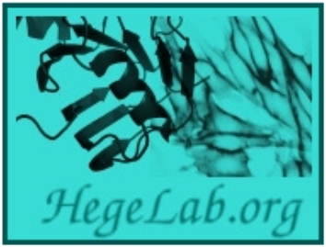
The highly increased number of protein structures
calls for high performance algorithms
Tamás Hegedűs
tamas@hegelab.org
Dept. Biophysics and Radiation Biology, Semmelweis University

Slide 2
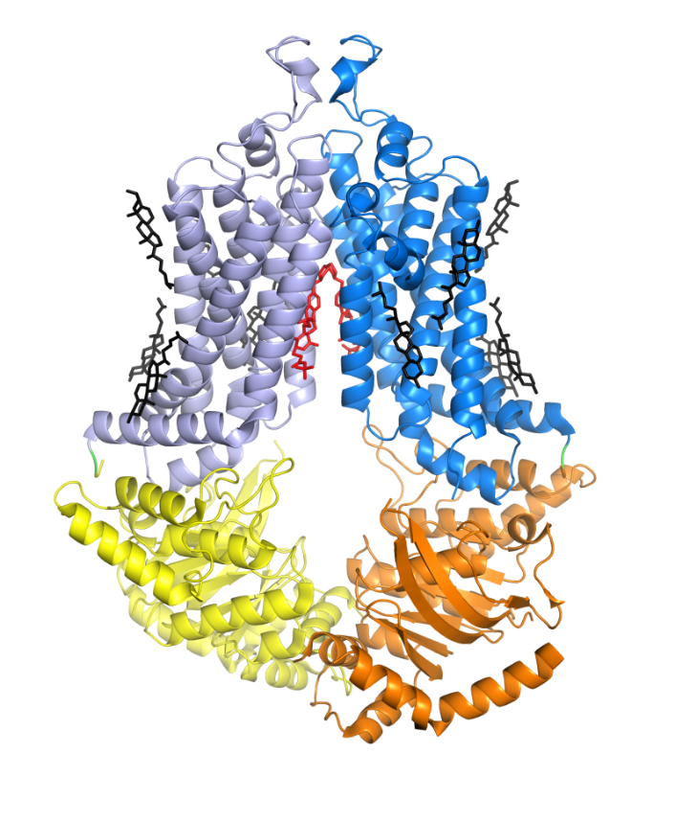
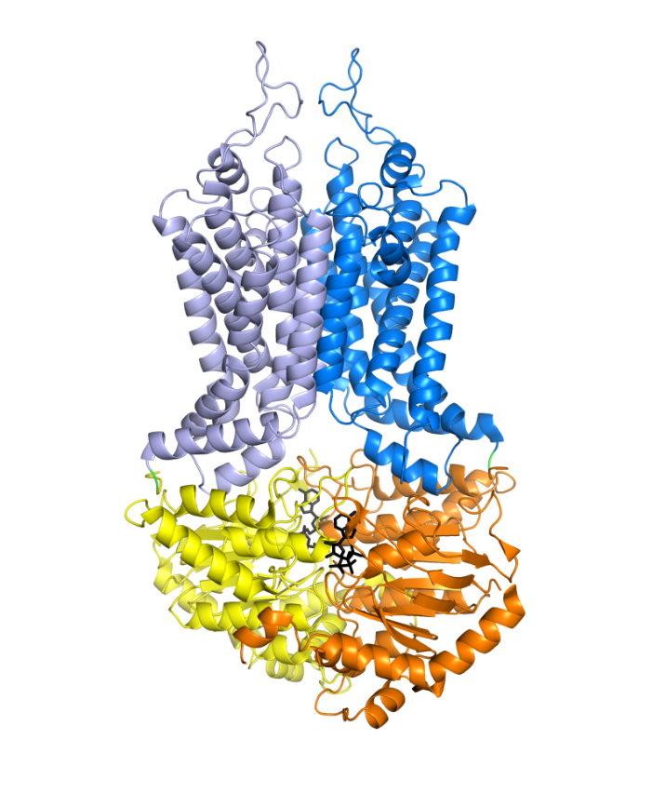
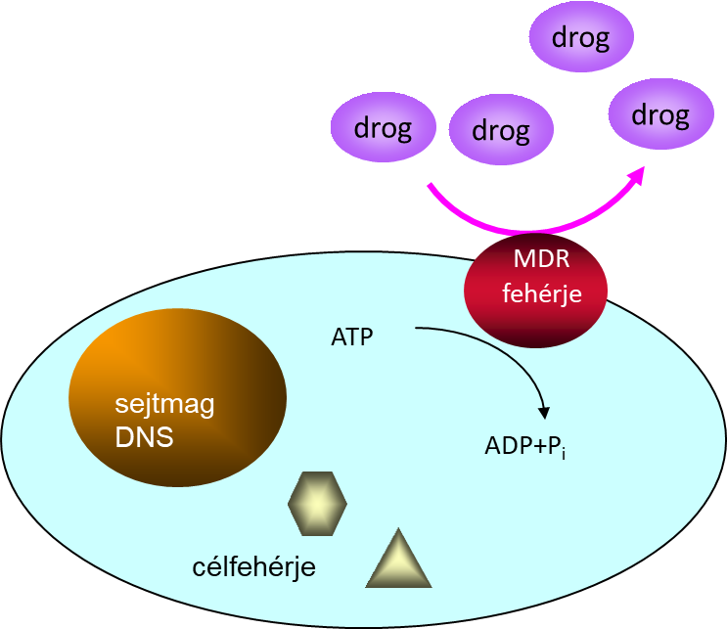
The ABCG2 multidrug transzporter
6HIJ
6HZM

Slide 3
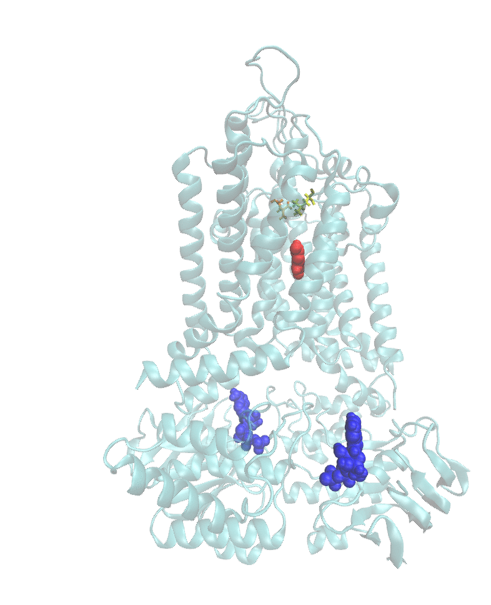
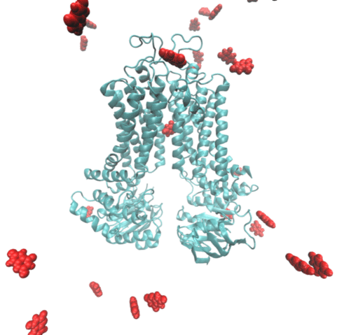
Describing the transport process
equilibrium molecular dynamics and metadynamics
Nagy et al. CMLS 2021

Slide 4
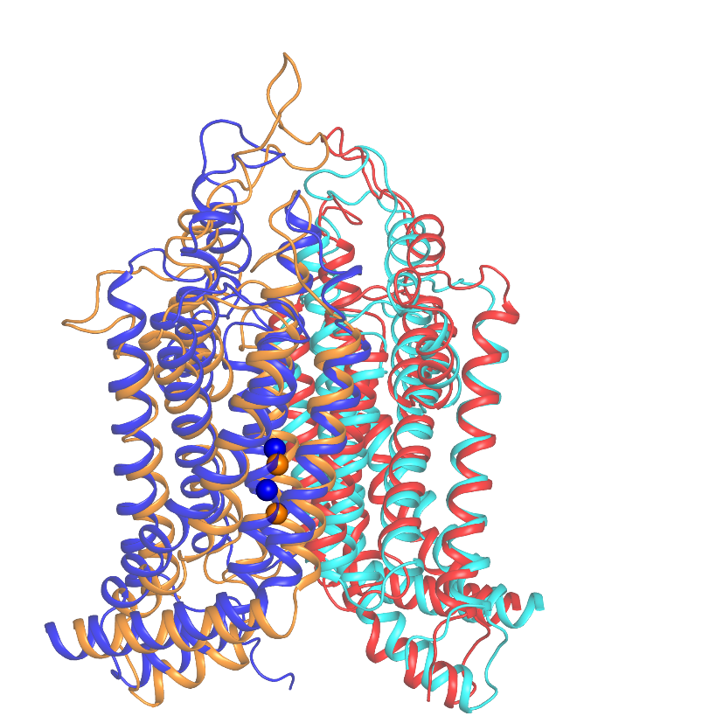
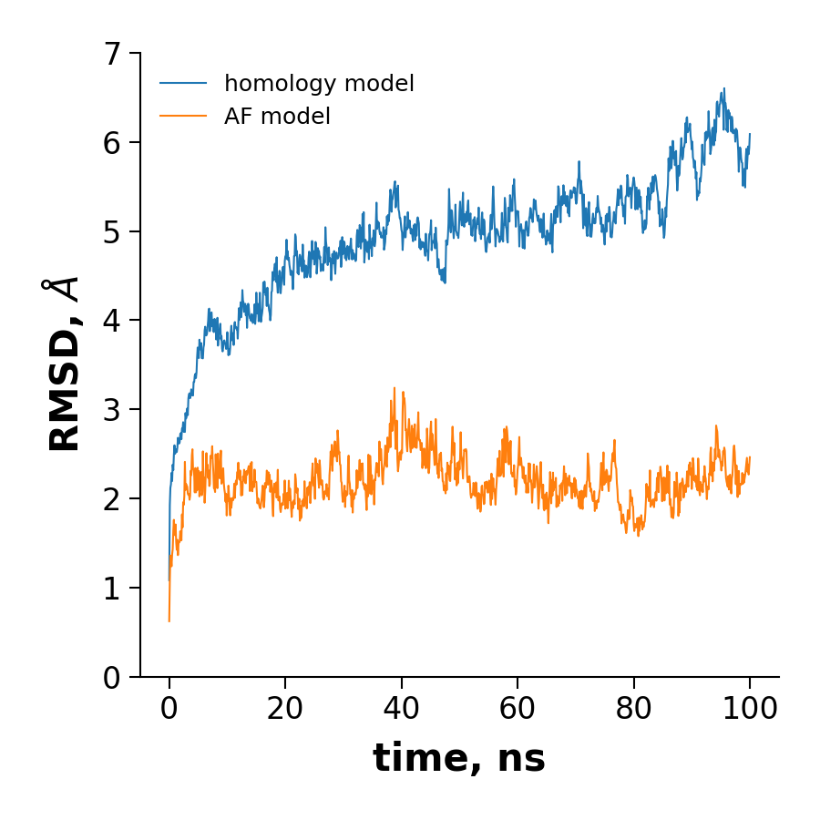
Plant ABCG36
growth hormones, xenobiotics
Hegedus et al. CMLS 2022

Slide 5
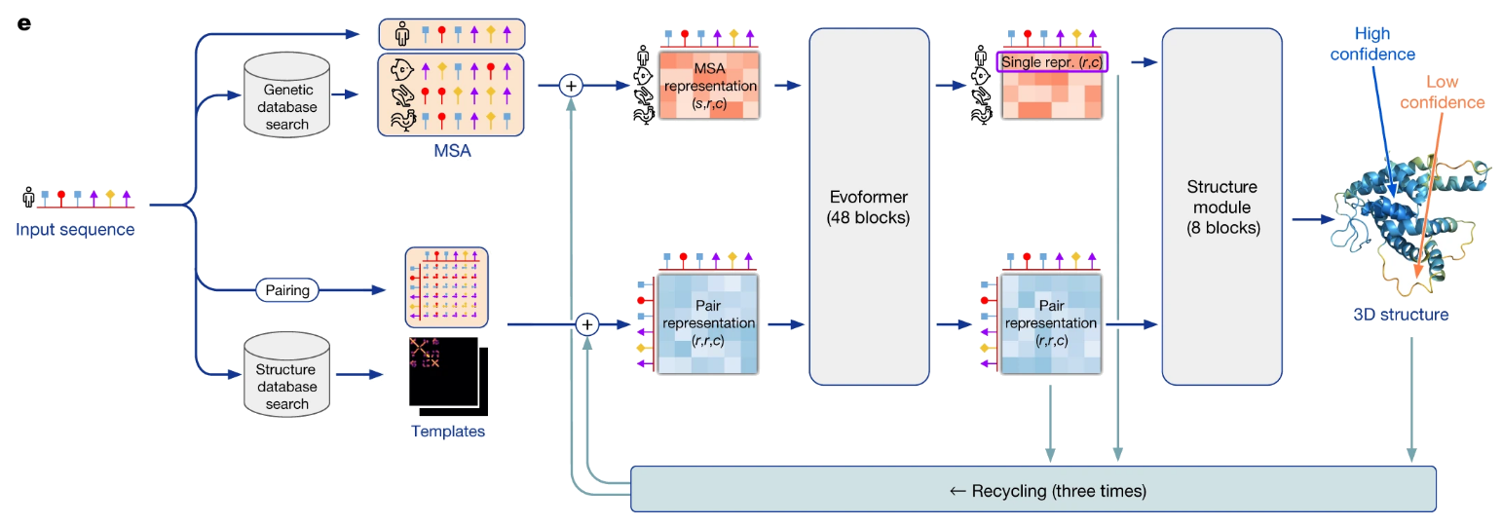
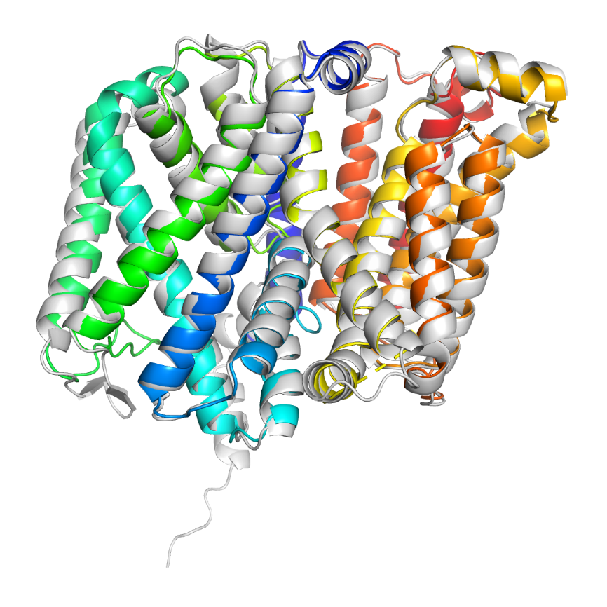
AlphaFold2
machine learning, deep learning, AI
Jumper et al. Nat 2021
Hegedus et al. CMLS 2022

Slide 6
Objectives
Collection of (ABC) protein structures
Comparing sequences vs. structures
sequence
structure
function

Slide 7
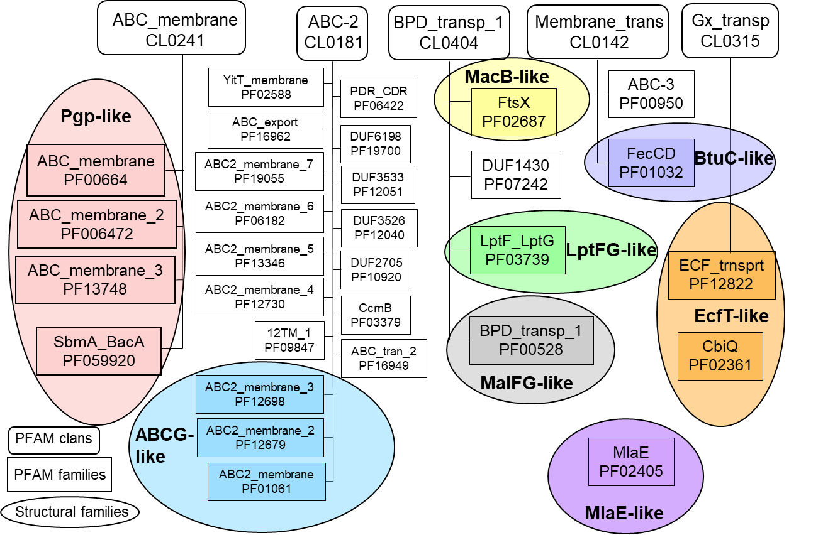
ABC TM Pfam families

Slide 8
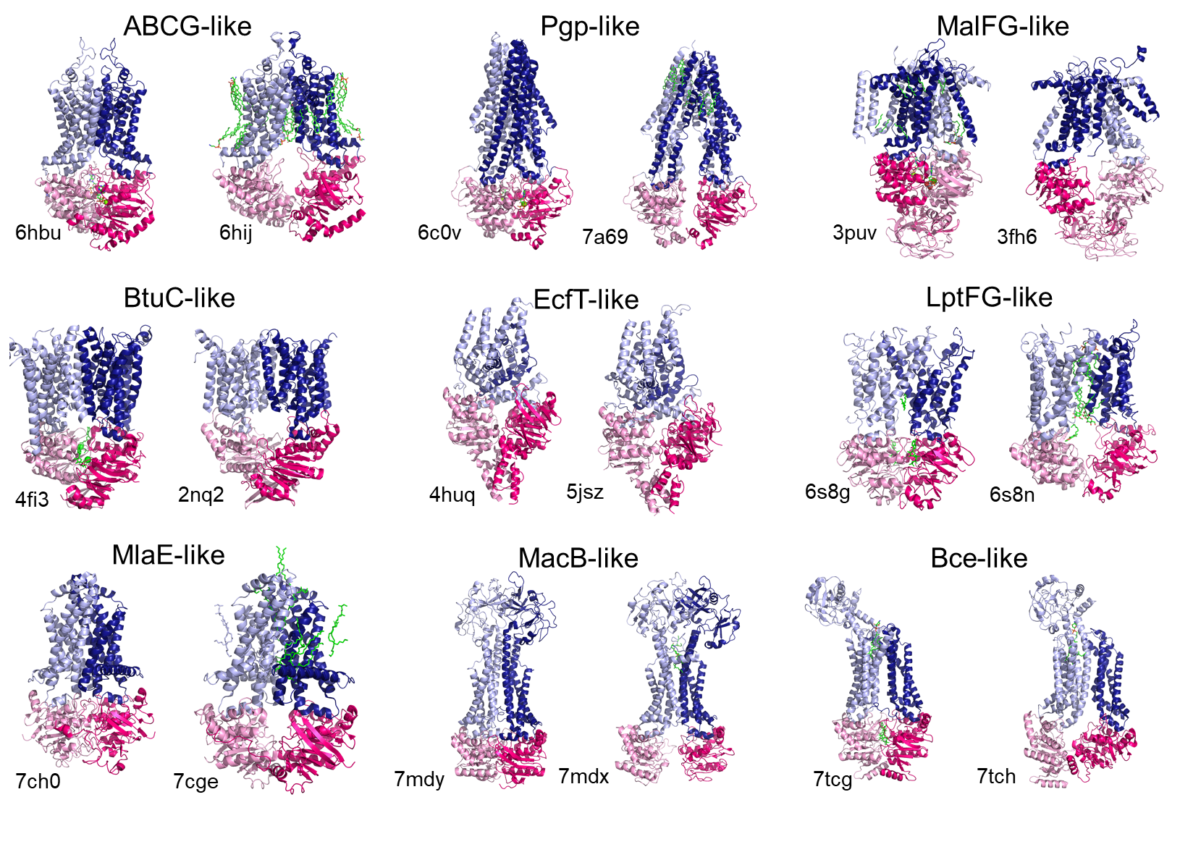
Structural ABC families

Slide 9
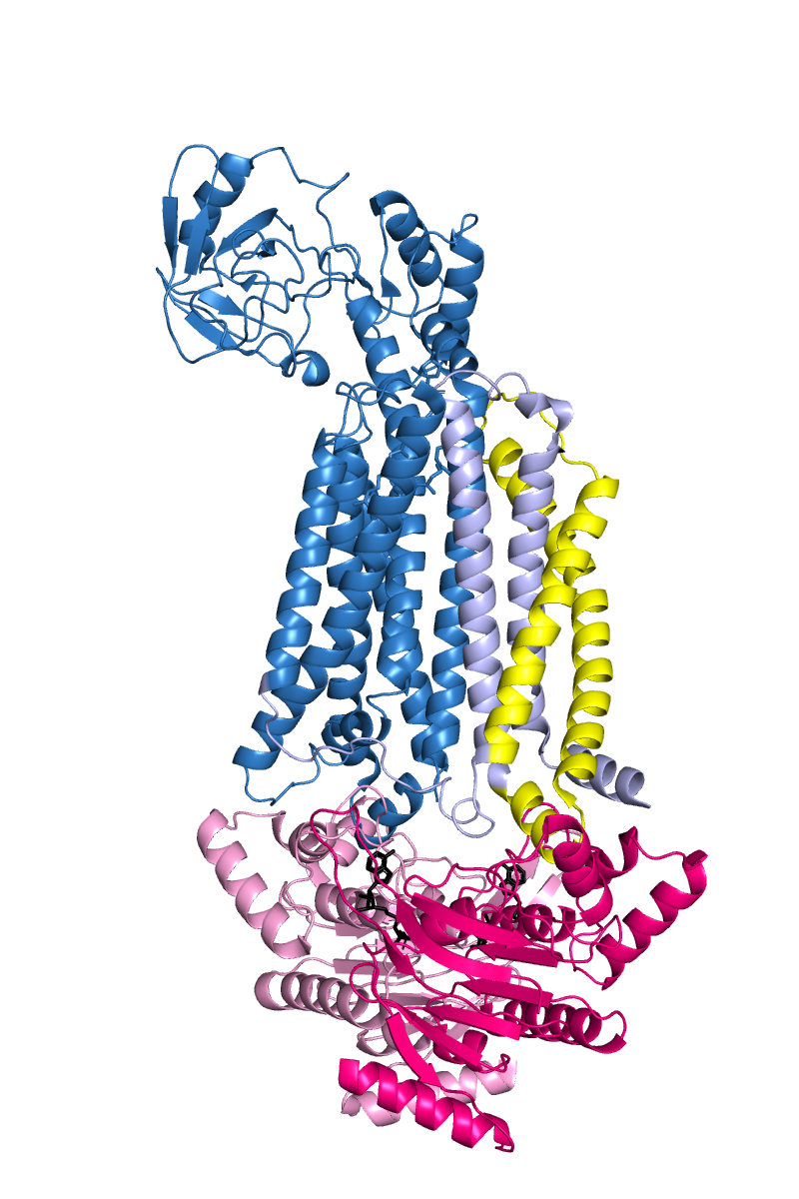
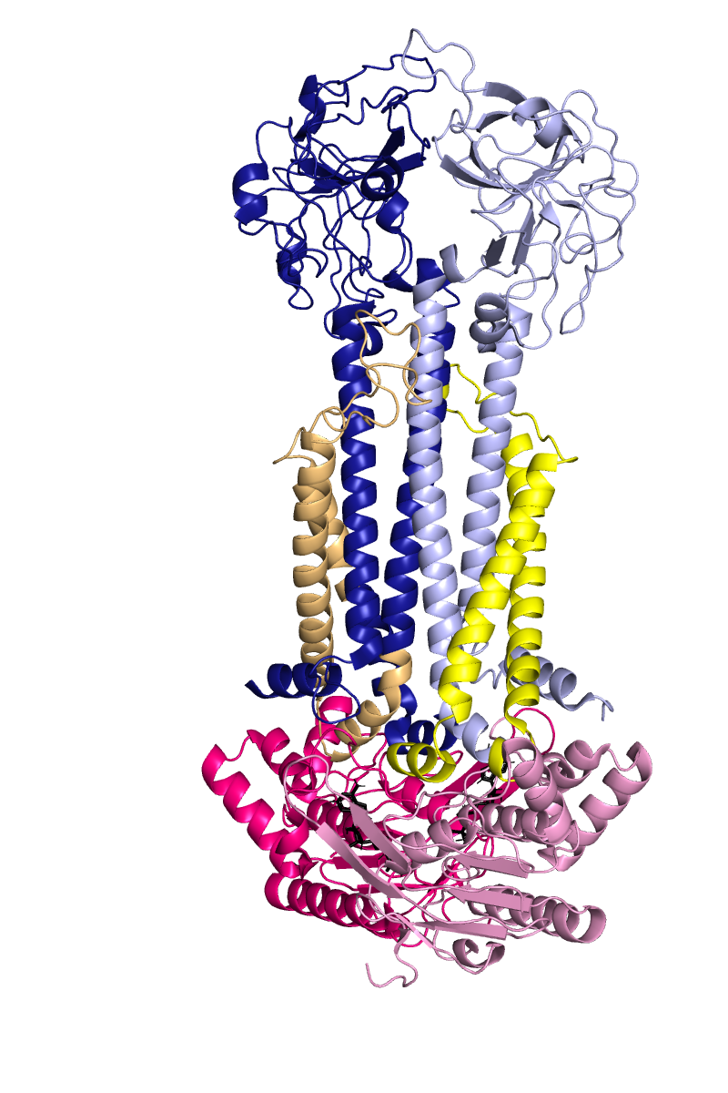
Pfam sequences do not cover a domain
MacB-like
Bce-like

Slide 10
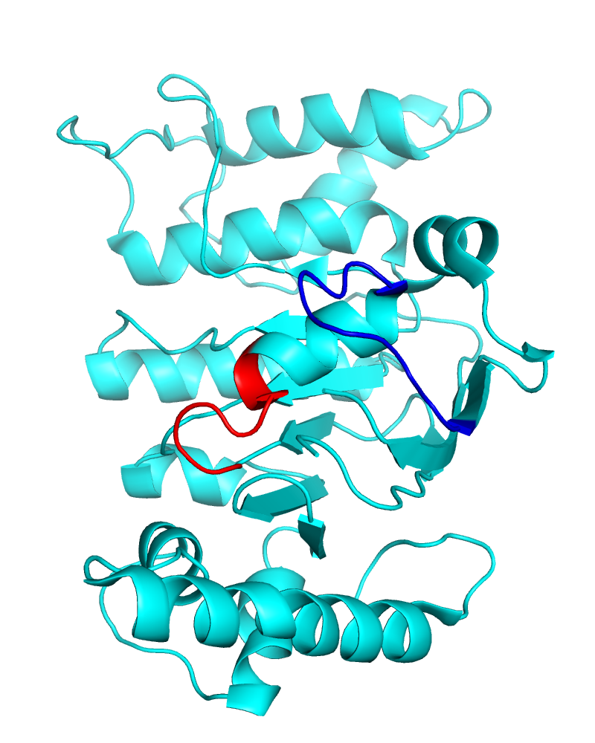
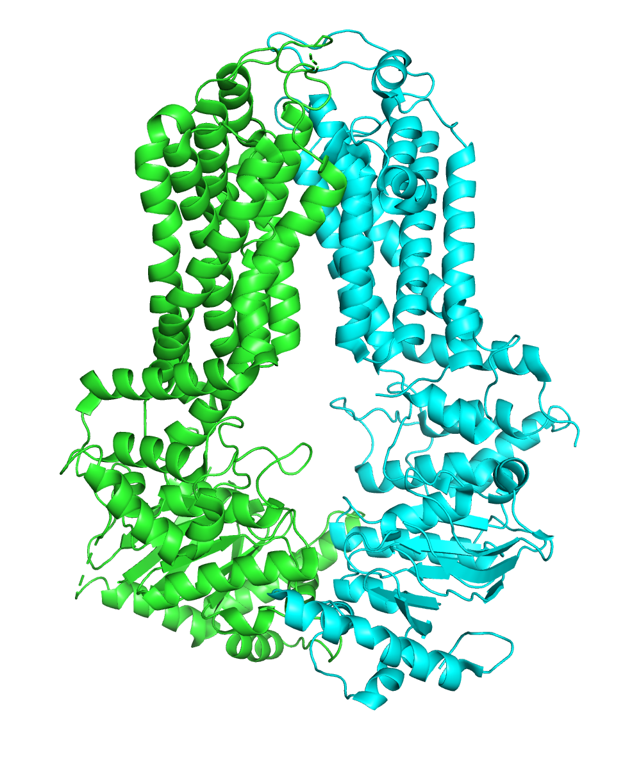
A conserved sequence is not a conserved structure
[AG]-x(4)-G-K-[ST]

Slide 11
Structure comparison
Experimental structures < 300K
Structures in AF Database ~1M
Structures in AF Database in July ~100M
TMalign
250 a.a. takes ~ 1 s
1500 a.a. takes ~10 s
Pairwise comparison of >10,000 structures?
Comparing 1 structure to 100M of structures?
Multidomain proteins – domains in all combinations?
My only GPU programing, CUDA: alignments from 23 min to 9 sec

Slide 12
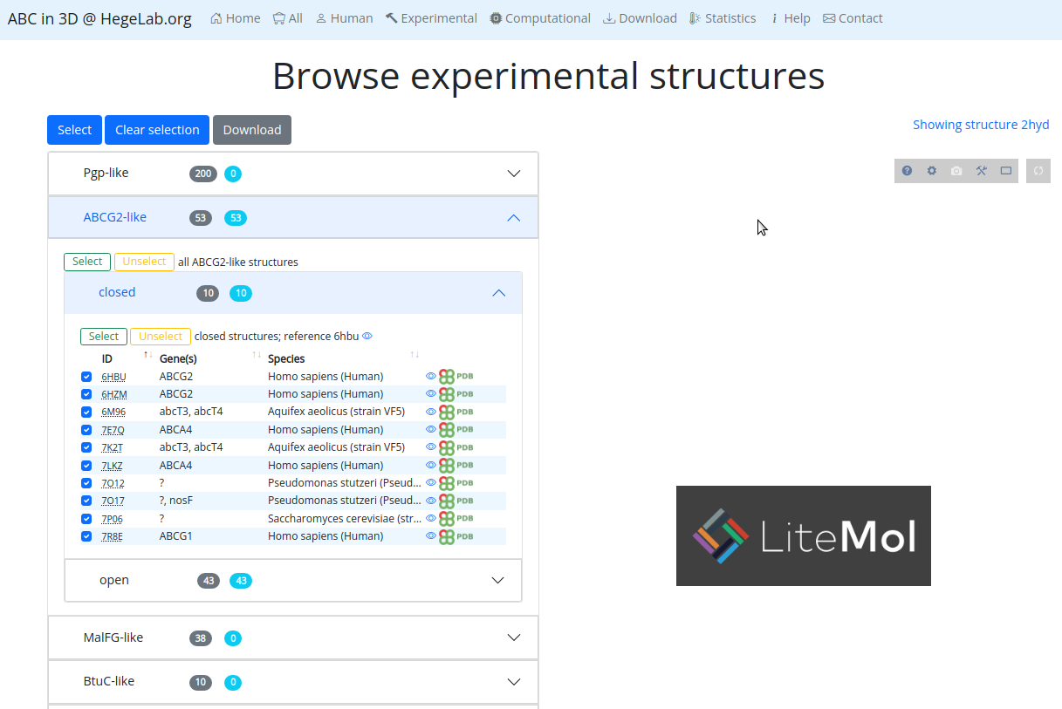
abc3d.hegelab.org
(not available yet… later this week)

Slide 13
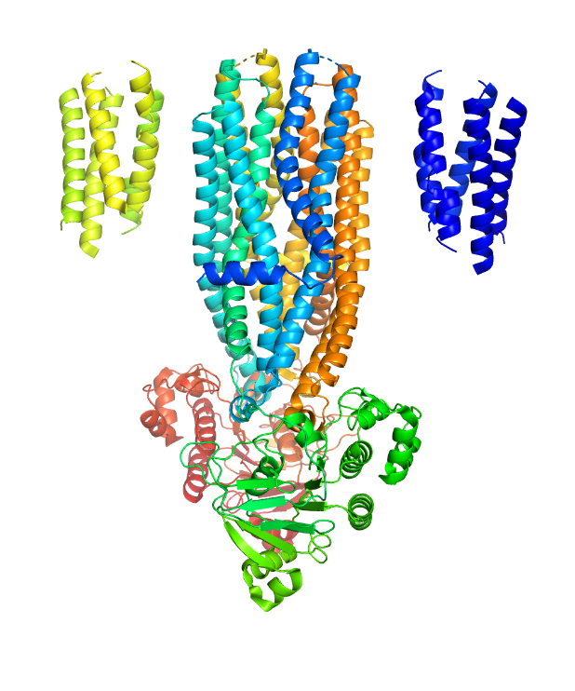
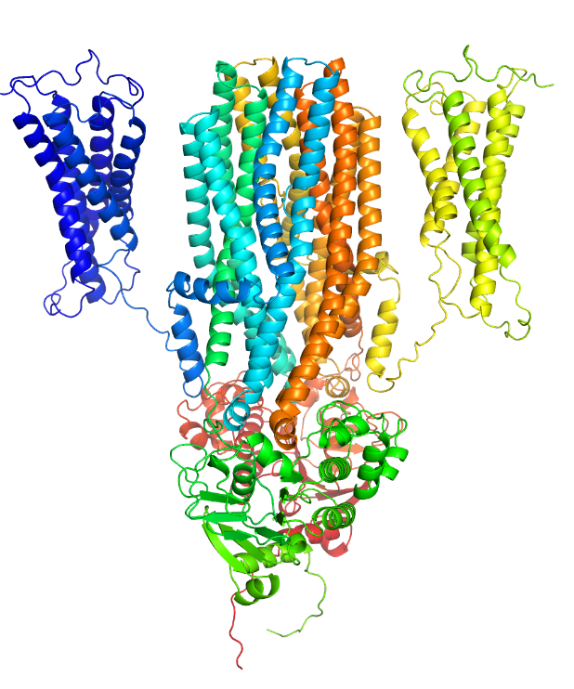
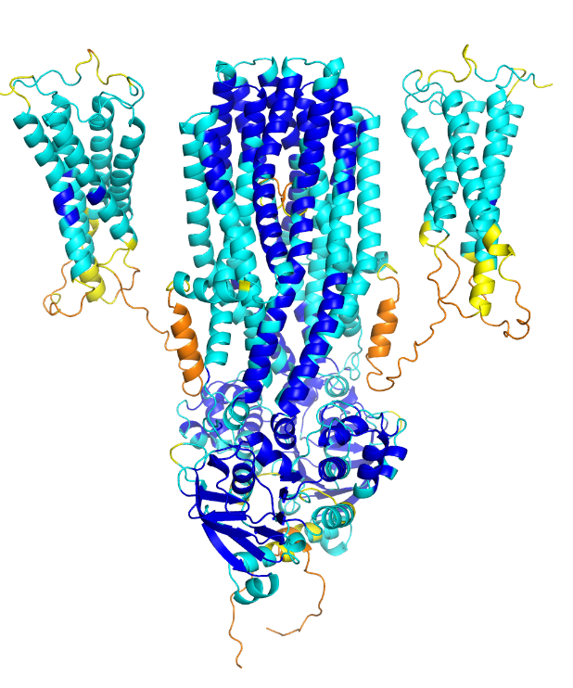
Structures of human ABC dimers

Slide 14
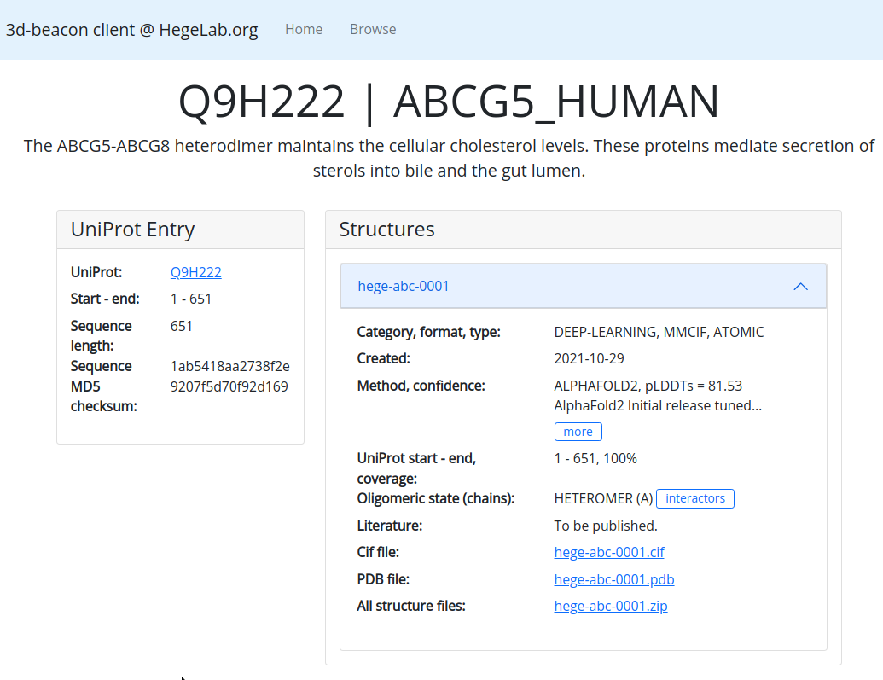
3dbeacon.hegelab.org

Slide 15
The 3D-Beacon Network
central
databases
servers
users
json
3D-Beacon
Registry & Hub
@EBI
PDBe-KB
UniProt
InterPro
e!Ensembl
mmCIF
browser
download
analysis
visualization
coordinates
xdata
json
3D-Beacon
Client
http://3dbeacon.hegelab.org
html (model_page_url)
mmCIF, pdb, xdata

Slide 16
Summary
Collecting ABC structures: abc3d.hegelab.org
Publishing ABC structures: 3dbeacons.hegleab.org
The age of big data in structural biology
comparative analysis of protein structures
Identifying tools/algorithms for (re)implementation
Defining API and data standards

Slide 17
Acknowlegements
hegelab.org
Mihály Váradi, EBI
Ian Sillitoe, UCL
3D-bioinfo, Elixir
Suhajda Erzsébet
Tordai Hedvig
Farkas Bianka
Csizmadia Gina+ReGina
Padányi Rita Lór Krisztina
Odalys Torres
MTA Wigner GPU Laboratórium
NIIF/KIFÜ HPC
Grubmüller laboratory, MPI, Göttingen
Támogatások:
CFF HEGEDU20I0
NKFI-127961 (2019-2023)

