Slide 1
Deep particle tracking for pCT detector system
GPU DAY 2025
2025.05.22-23
Speaker: Dudás Bence
Collaborators: Dr. Papp Gábor, Dr. Bíró Gábor
Bergen pCT collaboration

Slide 2
Overview
Hadron therapy
Proton Computed Tomography
Energy prediction for pCT
Hit position projection module
Particle matching module
Possible improvements

Slide 3
Hadron therapy
Promising cancer therapy and the tomography method for it.

Slide 4
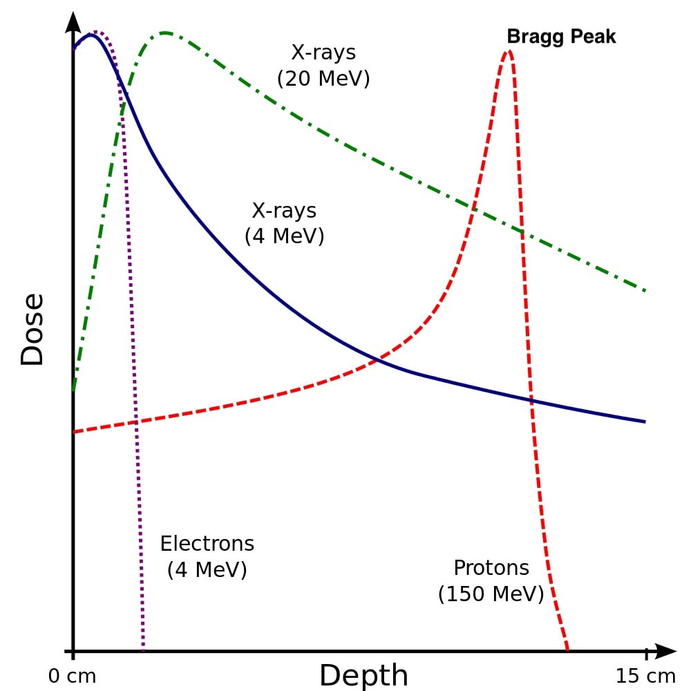
Hadron theraphy
Radiation based cancer therapy.
Using charged particles for more concentrated dose (compared to X-ray).
Ambulant treatment.
Current medical devices were not made for charged particles (protons in our case).
Medical imaging needs to be fast to optimal treatment.

Slide 5
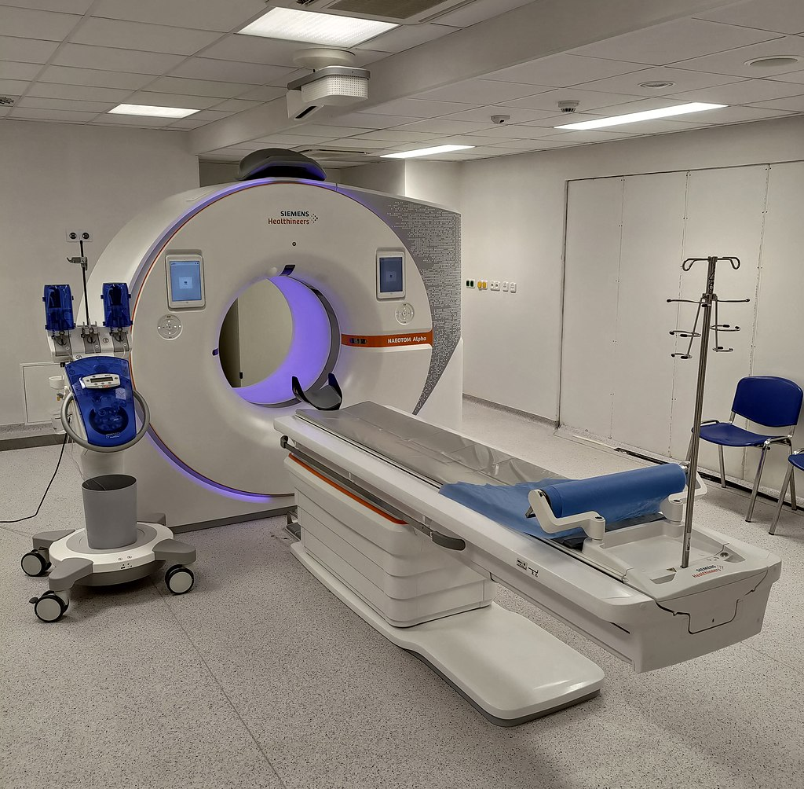
Computer Tomography
Rotating X-ray around the patient.
Detector in the other side.
Measuring incoming beam intensity.
Not designed for protons.
Can’t calculate proton stopping power.
Beam source
Phantom
Detector

Slide 6
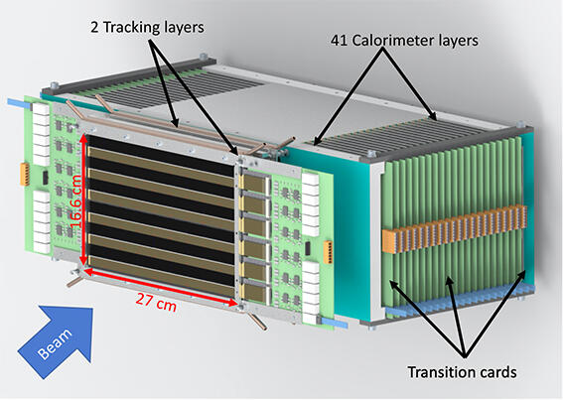
Proton CT
Beam in protons.
High energy protons (not to hurt patient).
Measure proton scattering (need more detector).
Beam source
Phantom
Detector system

Slide 7
Proton CT
Beam in protons.
High energy protons (not to hurt patient).
Measure proton scattering (need more detector).
Need to reconstruct particle trajectories.
We can calculate scattering angles and energies.
Rotating around detector system to have 3D image.
Beam source
Phantom
Detector system

Slide 8
Process of pCT
Beam in high energy protons
Detecting particle hits in detector system
Charged particle track reconstruction
Medical image generation
High enough to not harm the patient.
Using the pCT detector system.
Track trajectories and initial kinetic energy prediction (~100 particle at once).
Based on scattering angles and kinetic energies doing tomography.

Slide 9
Process of pCT
Beam in high energy protons
Detecting particle hits in detector system
Charged particle track reconstruction
Medical image generation
These take the most computational time.

Slide 10
Process of pCT
Beam in high energy protons
Detecting particle hits in detector system
Charged particle track reconstruction
Medical image generation
I concentrate on this.

Slide 11
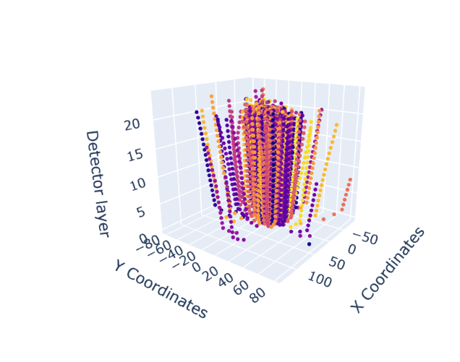
Motivation of machine learning
Fast evaluation (thanks to tensor nature).
Embarrassingly easy to parallelize.
Can learn complex functions.
What if we can do better than traditional algorithms?
Possible to merge multiple subtask into one model.
Designed for big data problems.
We need to process 100-200 particle in one frame.
Overall millions of tracks needs to be reconstructed.
Our models can run in medical devices.

Slide 12
Energy prediction
This is the easiest part, can be done by simple machine learning algorithms.

Slide 13
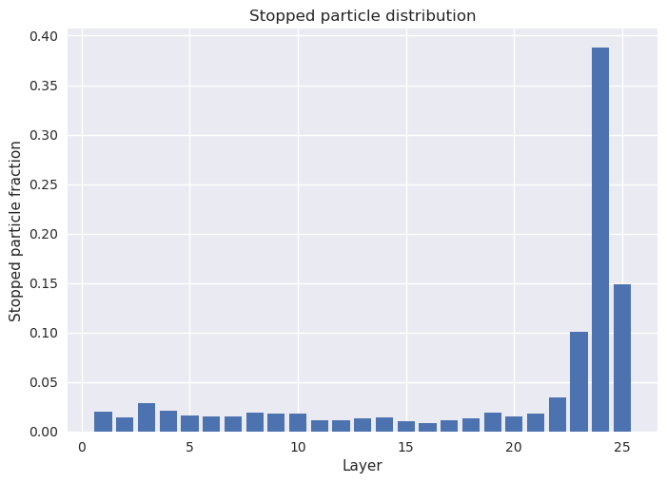
Energy prediction
Small neural network to approximate energies.
Filter data around expected Bragg peak.
In evaluation, we don’t know expected.

Slide 14
Energy prediction
We want to work with these!
Small neural network to approximate energies.
Filter data around expected Bragg peak.
In evaluation, we don’t know expected.

Slide 15
Energy prediction
We want to work with these!
Approximated from already reconstructed tracks.
Last particle with not 0 energy.
Alternatively, position of maximum energy deposition.
This will be our ,,expected Bragg peak’’.
Particles leaving the detector system are uniformly occurred everywhere.
These usually make the prediction worse.
With the maximum position we can make an assumption on the initial beam energy.

Slide 16
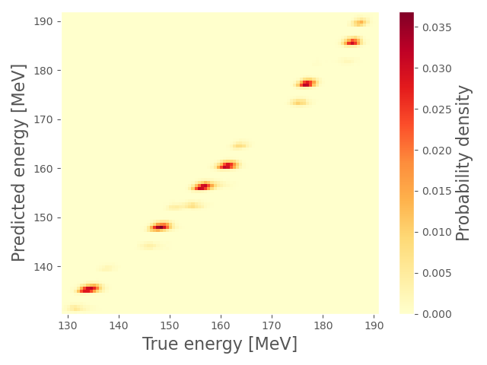
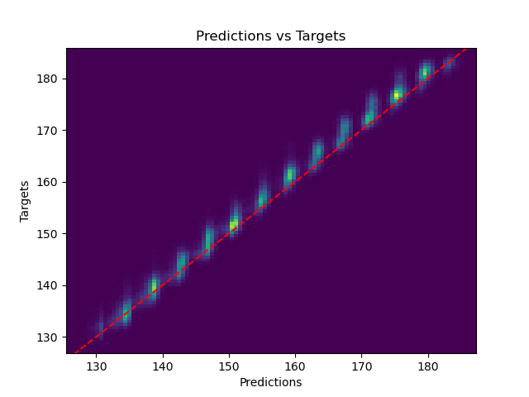
Energy prediction
Small neural network to approximate energies.
Originally linear regression was very close.
Deep neural nets slightly better.
Possible to merge NN with other subtasks.
Input of the model is:
$$\hat{X}=(L_{B},E_{B−1}/E_{B},E_{b+1}/E_{B})$$
Where $E_{B}$ is the energy deposition on the ,,expected’’ Bragg peak, $L_{B}$ the normalized position of the Bragg peak.
Some embedding might improve.
But currently this is enough for reconstruction.
[M. Aehle et al, Reconstruction of proton relative stopping power with a granular calorimeter detector model]

Slide 17
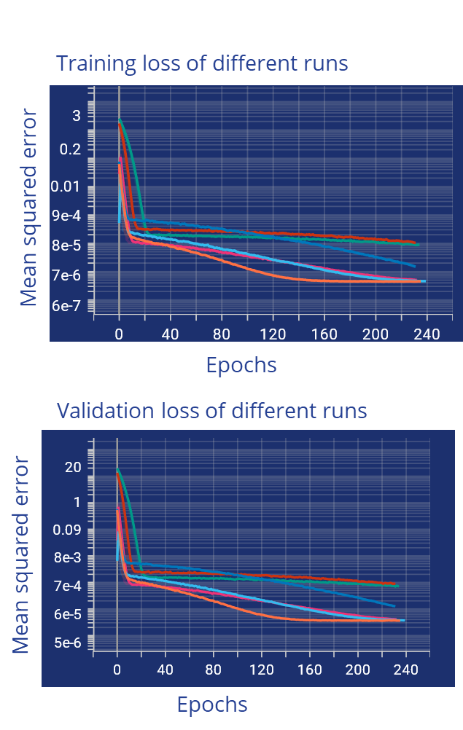
Energy prediction
Small neural network to approximate energies.
Originally linear regression was very close.
Deep neural nets slightly better.
Possible to merge NN with other subtasks.
Input of the model is:
$$\hat{X}=(L_{B},E_{B−1}/E_{B},E_{b+1}/E_{B})$$
Where $E_{B}$ is the energy deposition on the ,,expected’’ Bragg peak, $L_{B}$ the normalized position of the Bragg peak.
Some embedding might improve.
But currently this is enough for reconstruction.
We obtain around 1MeV precision.
Colors indicate hyperparameter configs

Slide 18
Tracking attempts
I have 2 proposed system for particle trajectory reconstruction. One is to help traditional algorithms, one is to replace them.

Slide 19
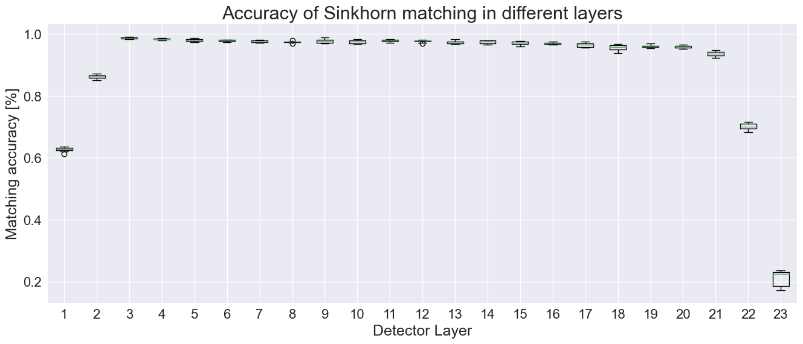
Particle matching in pCT system
Need match particles to recreate trajectories.
Matching in the calorimetric layers is very efficient.
For technical reasons we pad the trajectories.
This leads to small accuracy later.
This can be filtered in track reconstruction.
We have 2 approaches to this problem.
Position correction.
Matching Neural Network.
Closest particle matching around: 54%
Sinkhorn matching is around: 65%
The whole track reconstruction is even worse.

Slide 20
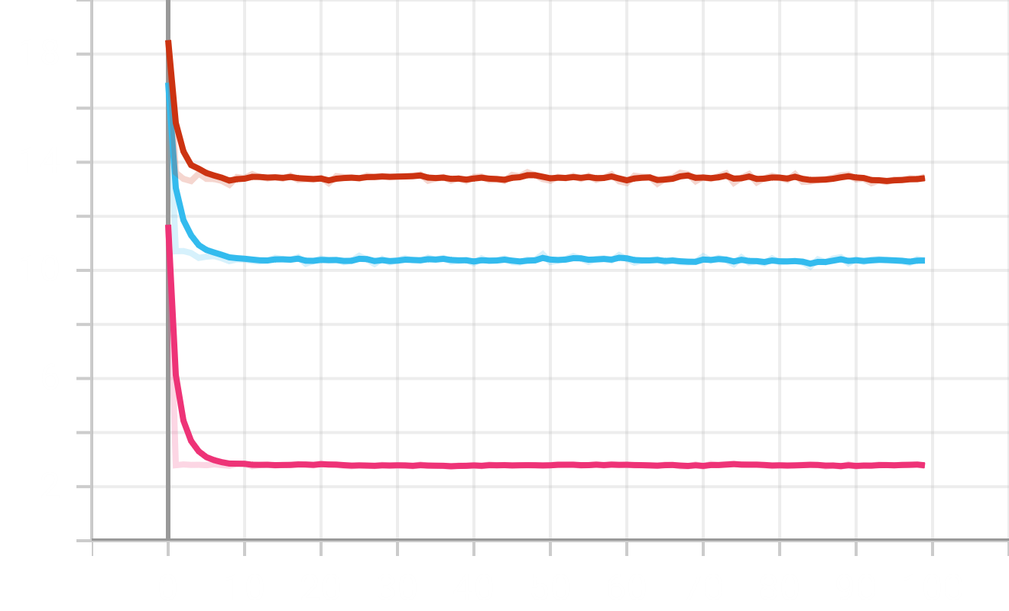
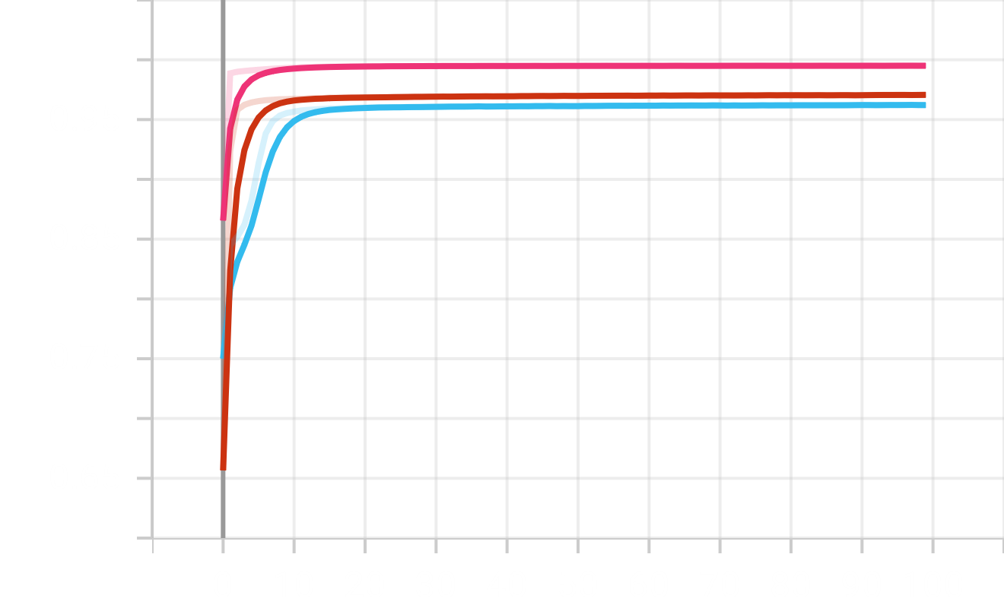
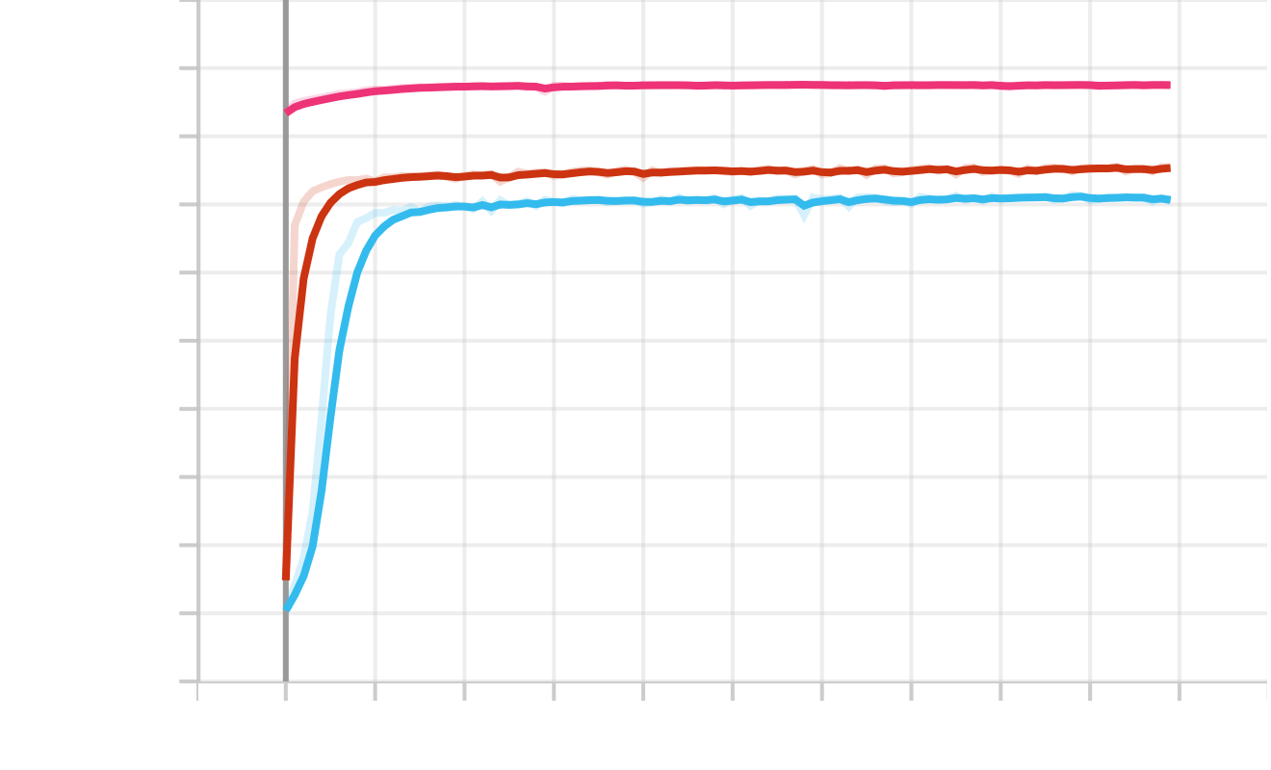
Position projection
Training loss for position prediction
Layer 3 to 2 prediction
Layer 2 to 1 prediction
We start from the end of the detector system.
Few particles, that are very easy to match.
In calorimetric layers we can do very good matching.
Based on previous position we predict an expected position.
We want to match expected position with the real one.
One-one model for the first 3 layers.
Layer 1 to 0 prediction
Mean squared error
Training accuracy
Validation accuracy
Accuracy
Epochs
Epochs

Slide 21
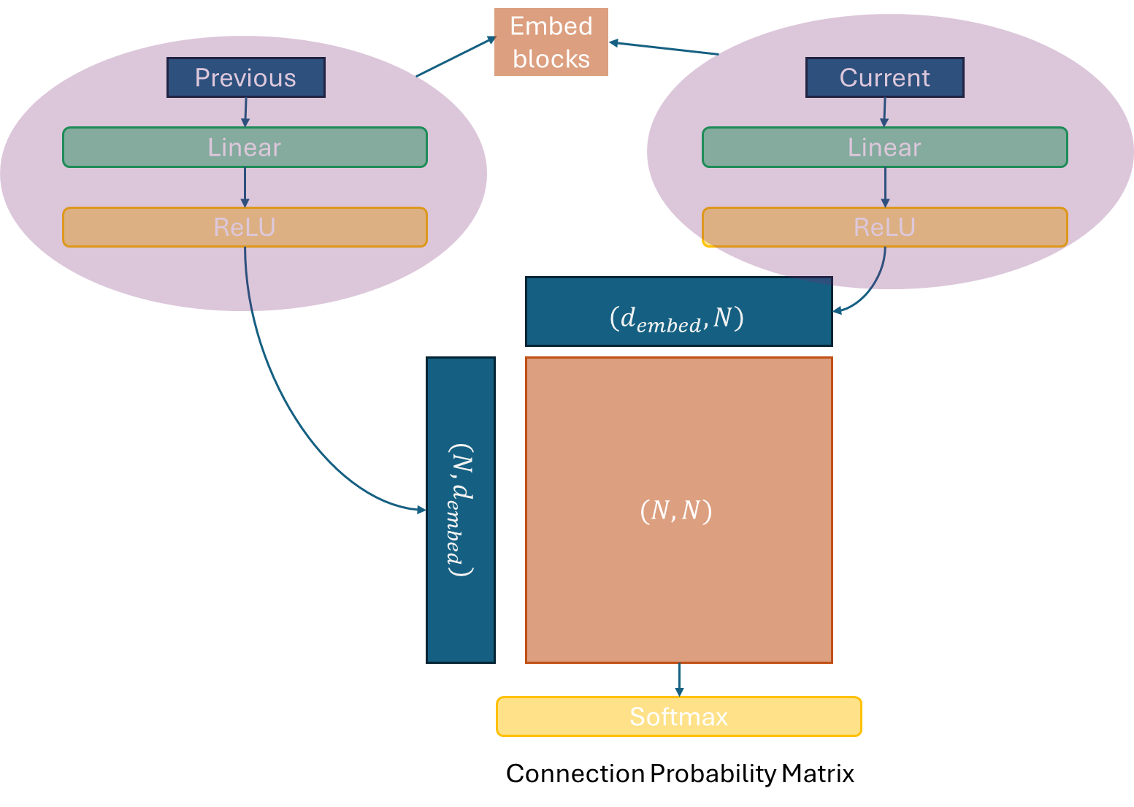
Deep particle matching
The results of the position projection was not so good originally.
What if we can replace the matching algorithms.
Create a deep neural network that mimic distance matrix creation.
We can add extra modules to it.

Slide 22
Deep particle matching
Normalize input before giving it to the model.
Creating a high dimensionel embeddig from input.
Shallow linear block don’t break normalization.
Multiply them with each other.
The closer they are the bigger the matrix element value.
Similar to attention.

Slide 23
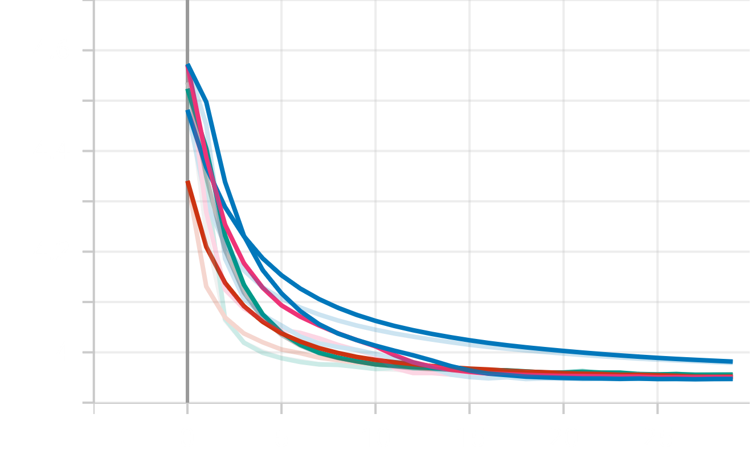
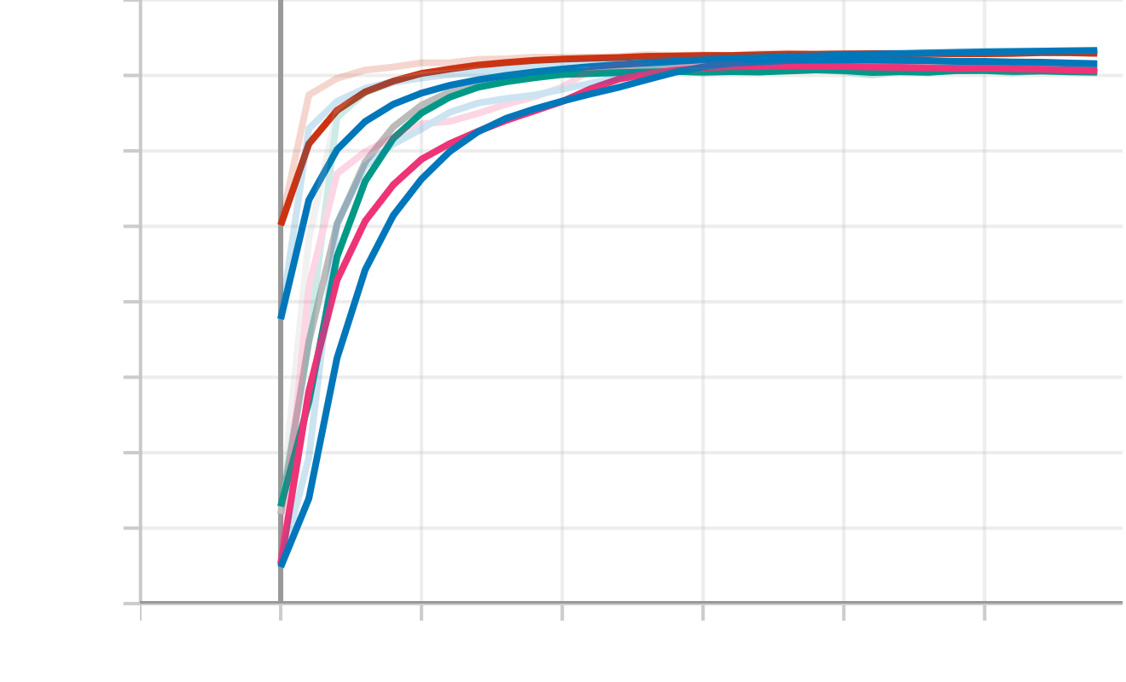
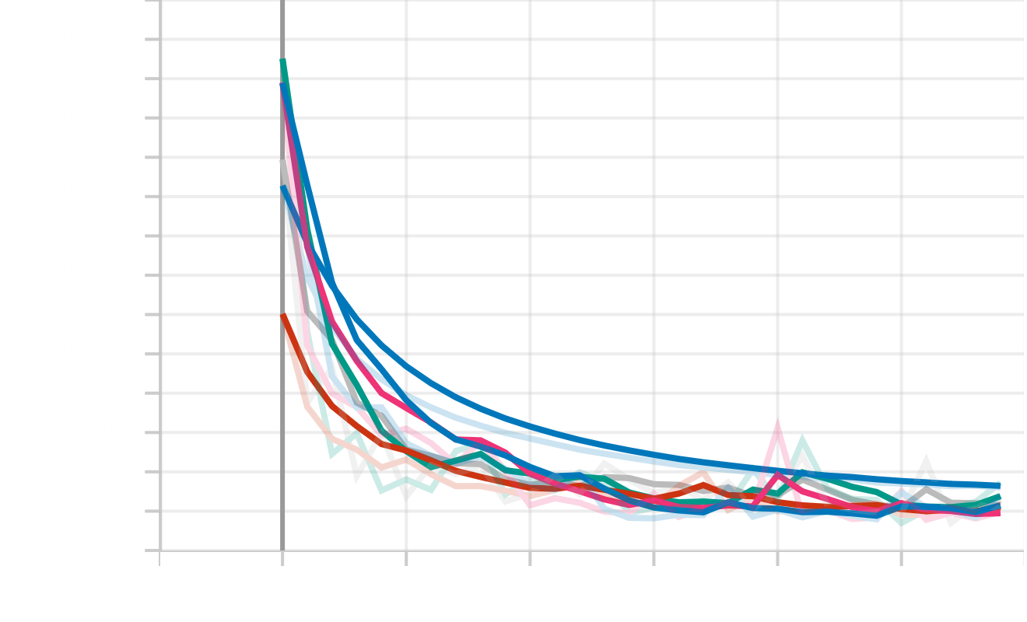
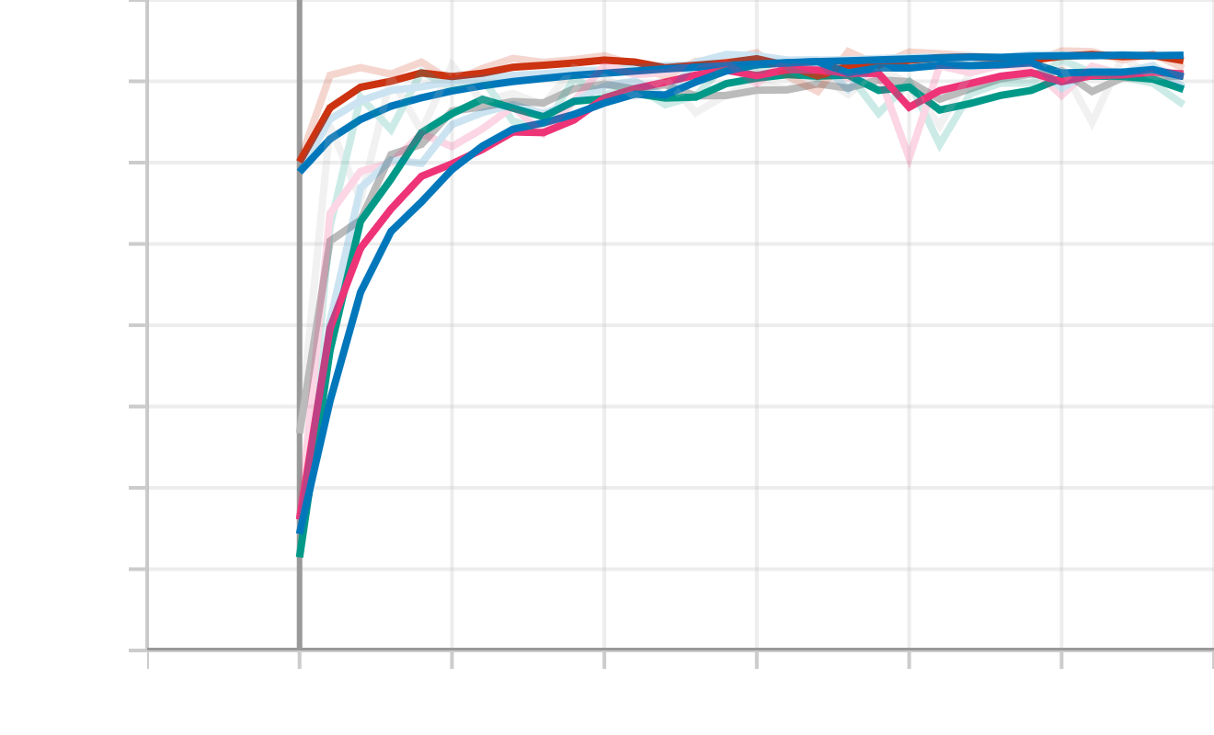
Deep particle matching
Training loss of different runs
Matching accuracy on training
Connection between two detector layer hits.
Deep neural nets evaluate quick.
Currently overperforms every traditional algorithm.
72% compared to 65%
Colors indicate different hyperparameters.
As you can see end up with very similar results.
Mean squared error
Matching accuracy
Epochs
Epochs
Validation loss of different runs
Matching accuracy in validation
Mean squared error
Matching accuracy
Epochs
Epochs

Slide 24
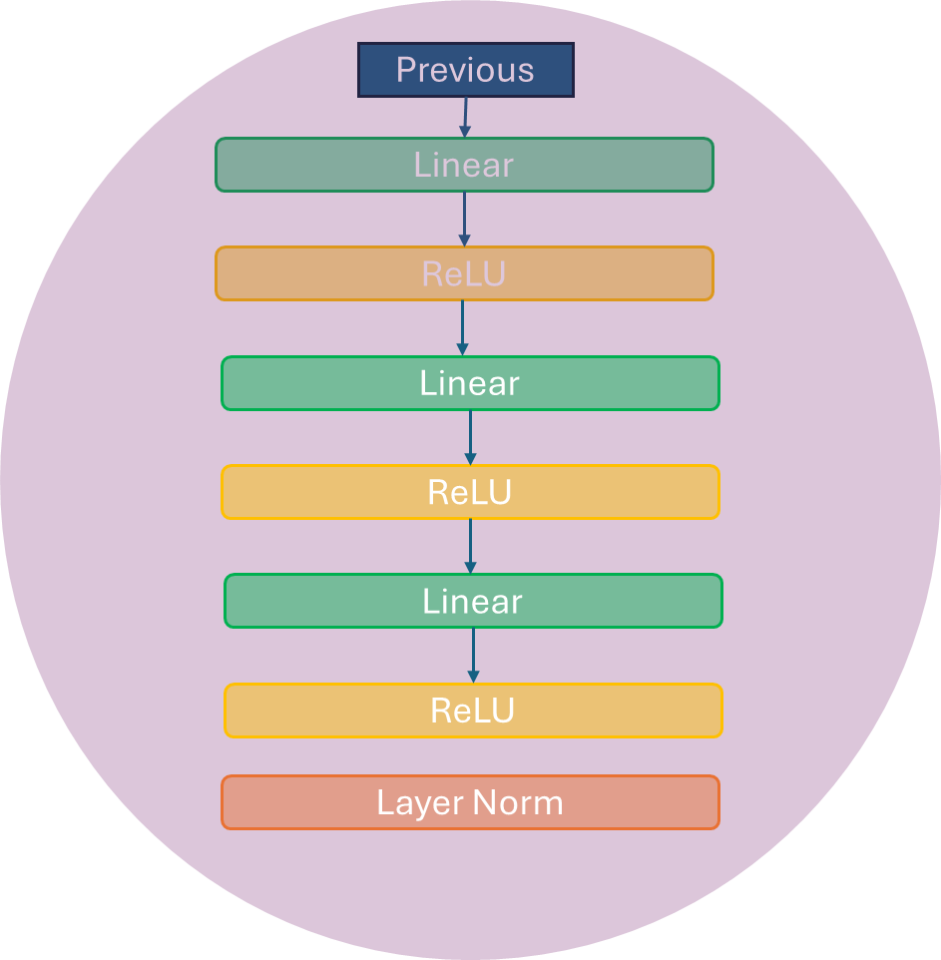
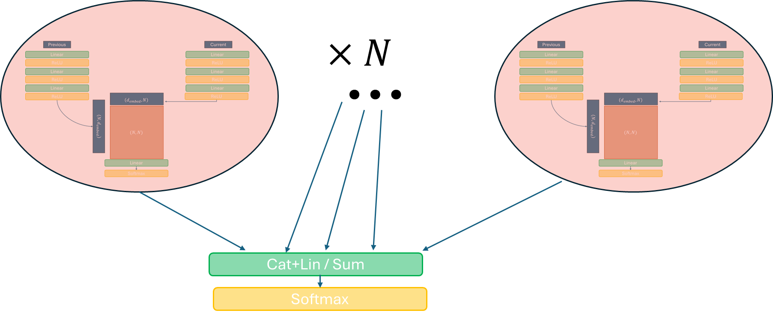
Possible improvements
Multi head attention doesn’t show improvement.
Trying to add multiple normalization step to enforce 1-1 matching.
The problem is that the gradients are vanishing.
Deeper embedding blocks are not making improvement.
Plans to do position projection in latent dimension and apply match block there.

Slide 25
Summary
Energy prediction
Promising method for particle hit projection to improve matching algorithms.
A possible replacement for particle matching.This might be good for other applications.
Future plans
Good enough results to medical imaging. More about it in the next talk.
Position projection model
Attention-like particle matching
Proposed some possible improvements on the current results.

Slide 26
Thank you!
Supporters:
Hungarian Artificial Intelligence Laboratory, under the ID: RFF-2.3.1-21-2022-00004
SUPPORTED BY THE DKOP-23 DOCTORAL EXCELLENCE PROGRAM OF THE MINISTRY FOR CULTURE AND INNOVATIONFROM THE SOURCE OF THE NATIONAL RESEARCH, DEVELOPMENT AND INNOVATION FUND.
Wigner Scientific Computer Laboratory

Slide 27
Resources
Johan Alme et all, A High-Granularity Digital Tracking Calorimeter Optimized for Proton CT, Frontiers in Physics (2020), doi: 10.3389/fphy.2020.568243
Robert P Johnson, Review of medical radiography and tomography with proton beams, Rep. Prog. Phys. (81) (2018) 016701, doi: 10.1088/1361-6633/aa8b1d.
M. Mager et all, ALPIDE, the Monolithic Active Pixel Sensor for the ALICE ITS upgrade, Elsevier 434-438 (2016), doi 10.1016/j.nima.2015.09.057
H.E.S. Pettersen et all, Design optimization of pixel-based range telescope for proton computed tomography, Physica Medica 87-97 (2019) doi:https://doi.org/10.1016/j.ejmp.2019.05.026

