Slide 1
Roland Jakab
CEO, HUN-REN President, AI Coalition
HUN-REN AI for Impact
4 April 2025
Budapest
https://hun-ren.hu/ai-4-science

Slide 2
Covering one aspect is not enough
How can we support all types of activities within science?
Supporting scientist in research process
(AI4S)
Enhancing support functions with AI
(AI4E)
Supporting the innovation value chain with AI
(AI4I)
Disrupting science with AI
(AI1S)
AUGMENTED Intelligence support
AUTONOMOUS Intelligence exploration
AUTOMATED Intelligence support

Slide 3
Comprehensive Program to Enhance AI Usage in the Research Network – AI 4 Science Program
PROGRAMME GOALS
Integrating AI tools into research activities
Unlocking new research opportunities through AI
Boosting the efficiency of research with AI tools
Enhancing the AI skills of HUN-REN researchers
AI SUPPORT FOR RESEARCHERS
Inspiration for exploring AI applications
Training to build and expand skills
Consulting to foster collaboration and innovative thinking
Technological support to increase the efficiency of research work
SERVICE OVERVIEW
Institutional AI Ambassador Network
Central AI support services:
AI education and training (basic and advanced courses)
Personalized AI support (expert teams and partner matchmaking)
Access to AI technologies (custom AI frameworks and computational infrastructure)

Slide 4
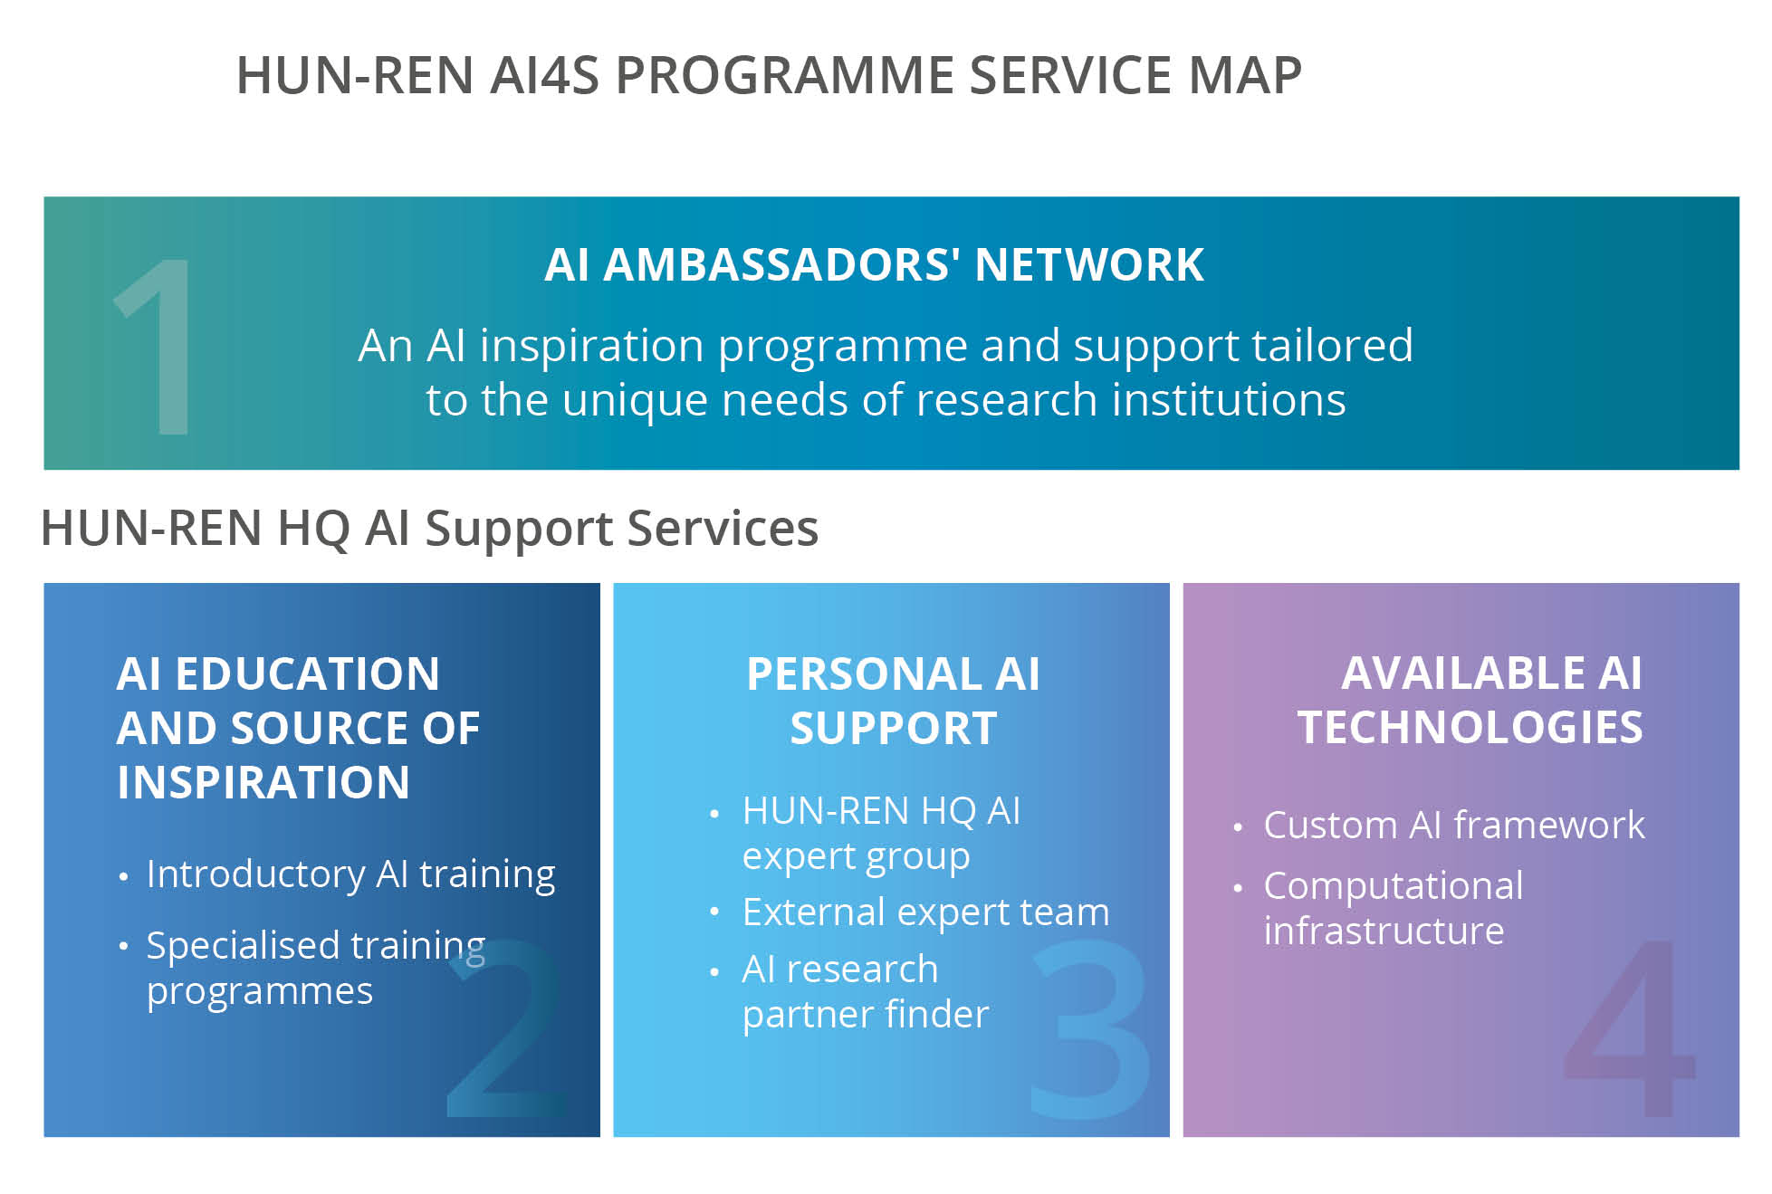
AI for Science program - services
AUGMENTED Intelligence
Organisational focus:
Choosing tools, trainings and engagement, culture change

Slide 5
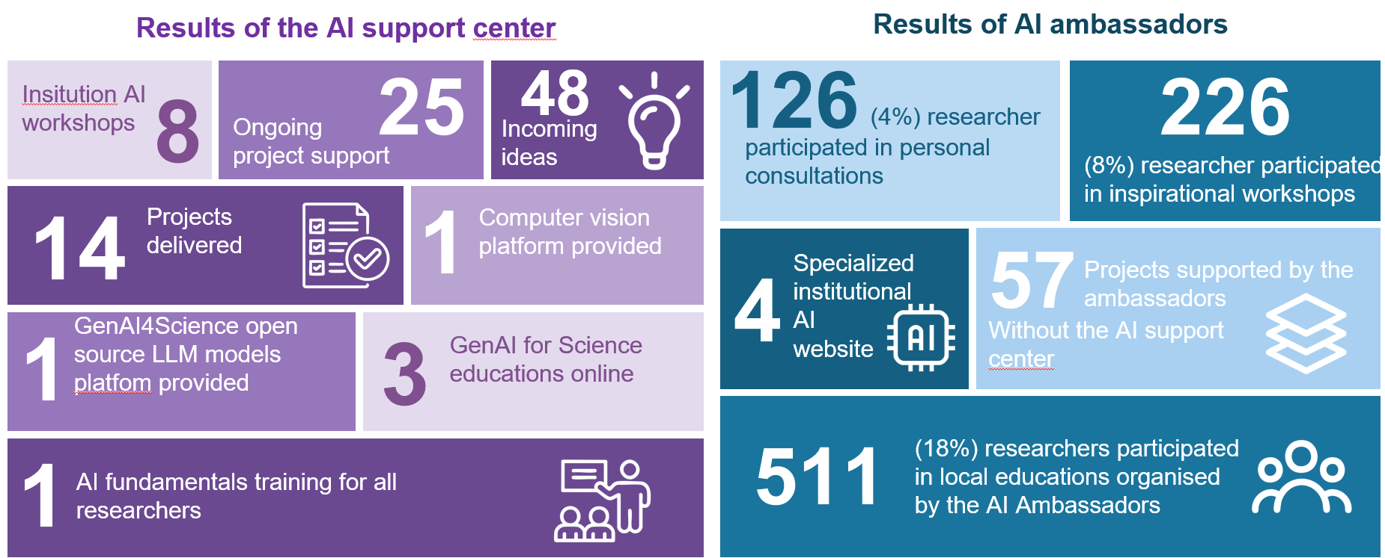
AI for Science program - results of the first 3 months
AUGMENTED Intelligence
Organisational focus:
Choosing tools, trainings and engagement, culture change

Slide 6
AI for Innovation – leveraging on specialist agents
Virtual ideation team: from innovation to value propositons and potential personas
AUTOMATED Intelligence
Organisational focus
Developing AI automated processes, integrating virtual and human processes, developing quality assurance of processes

Slide 7
AI for Innovation
Goal: supporting the whole value chain with agents
TRL 1-3
TRL 4-6
TRL 7-9
Applied research
Product development
Marketable product
Selling expertise
Local interest product
Patent
Scalable product
RnD SUPPORT
INCUBATION
GO TO MARKET
AUTOMATED Intelligence
Patent research
Ideas for productification
Science-communication
Product refinement
Competitor analysis
Producing marketing materials
Finding partners
First contact email
Creating pitch-deck

Slide 8
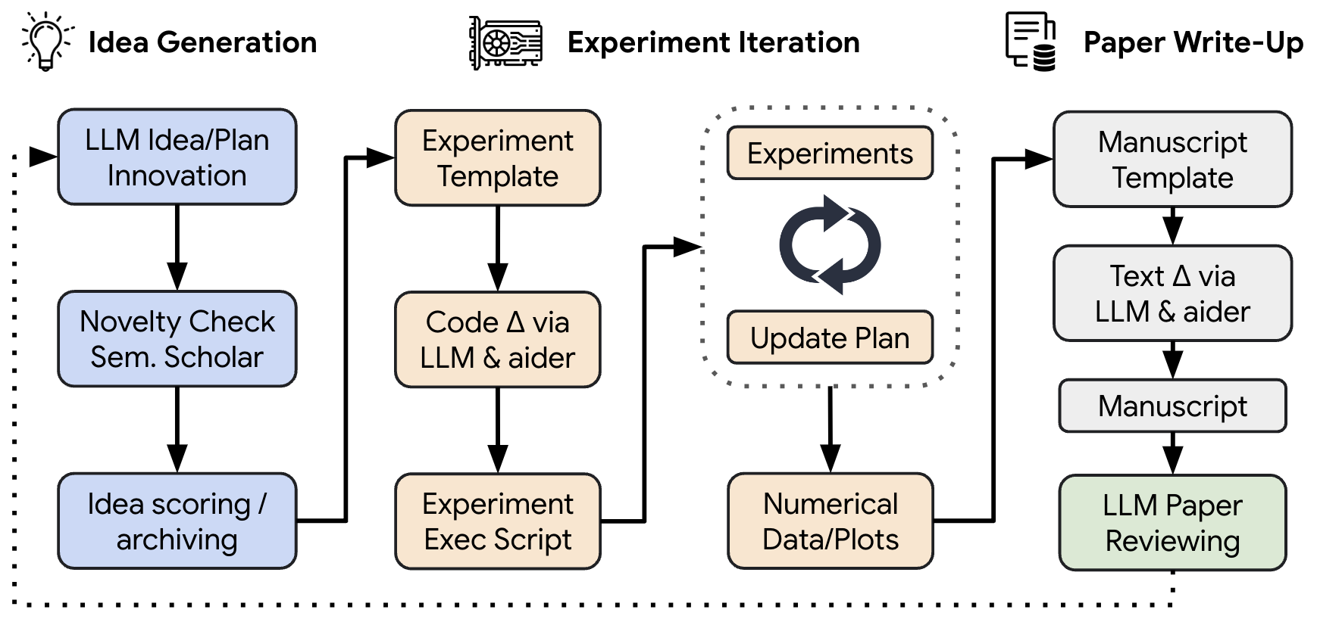
Self Standing AI Scientist?

Slide 9
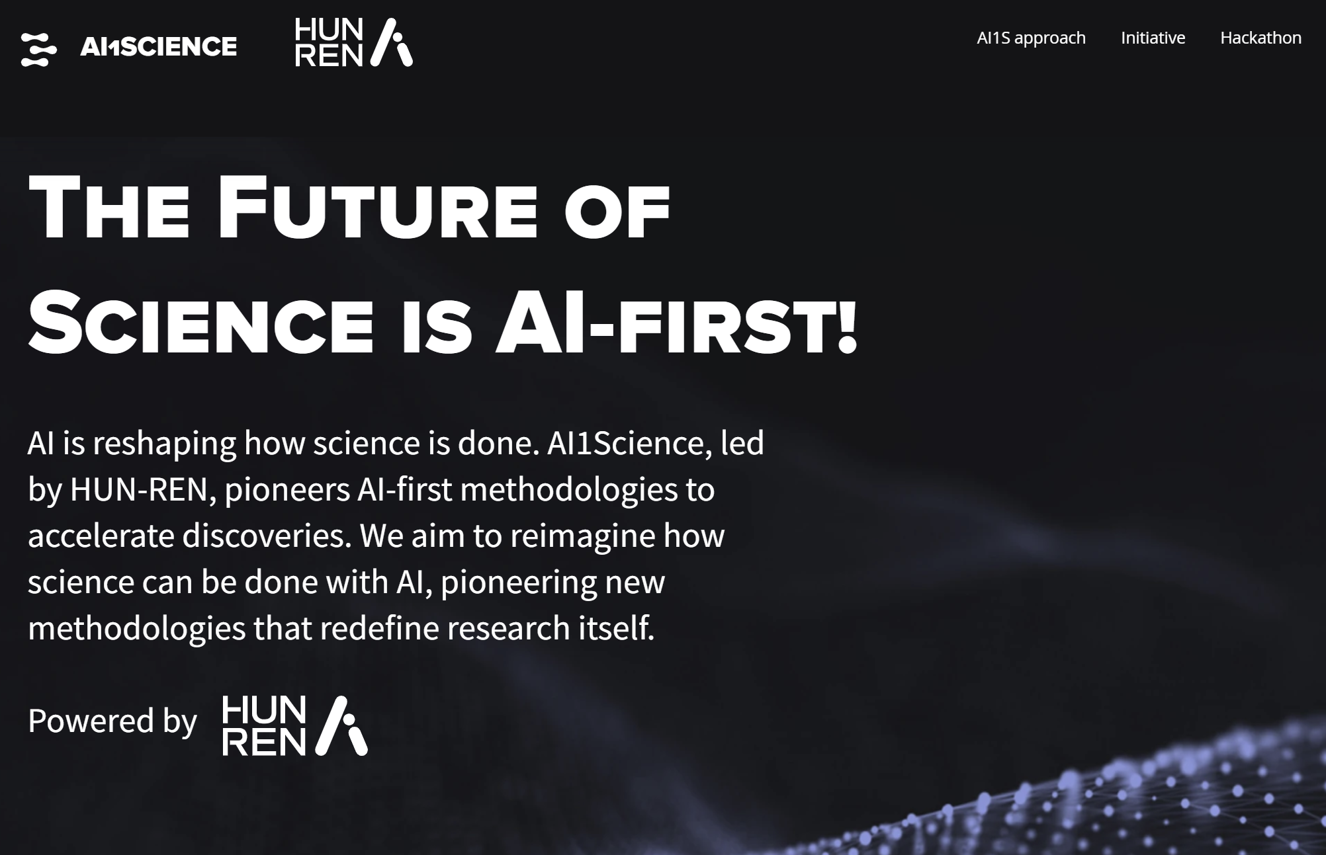
AI-first Science – www.ai1science.com
AUTONOMOUS Intelligence

Slide 10
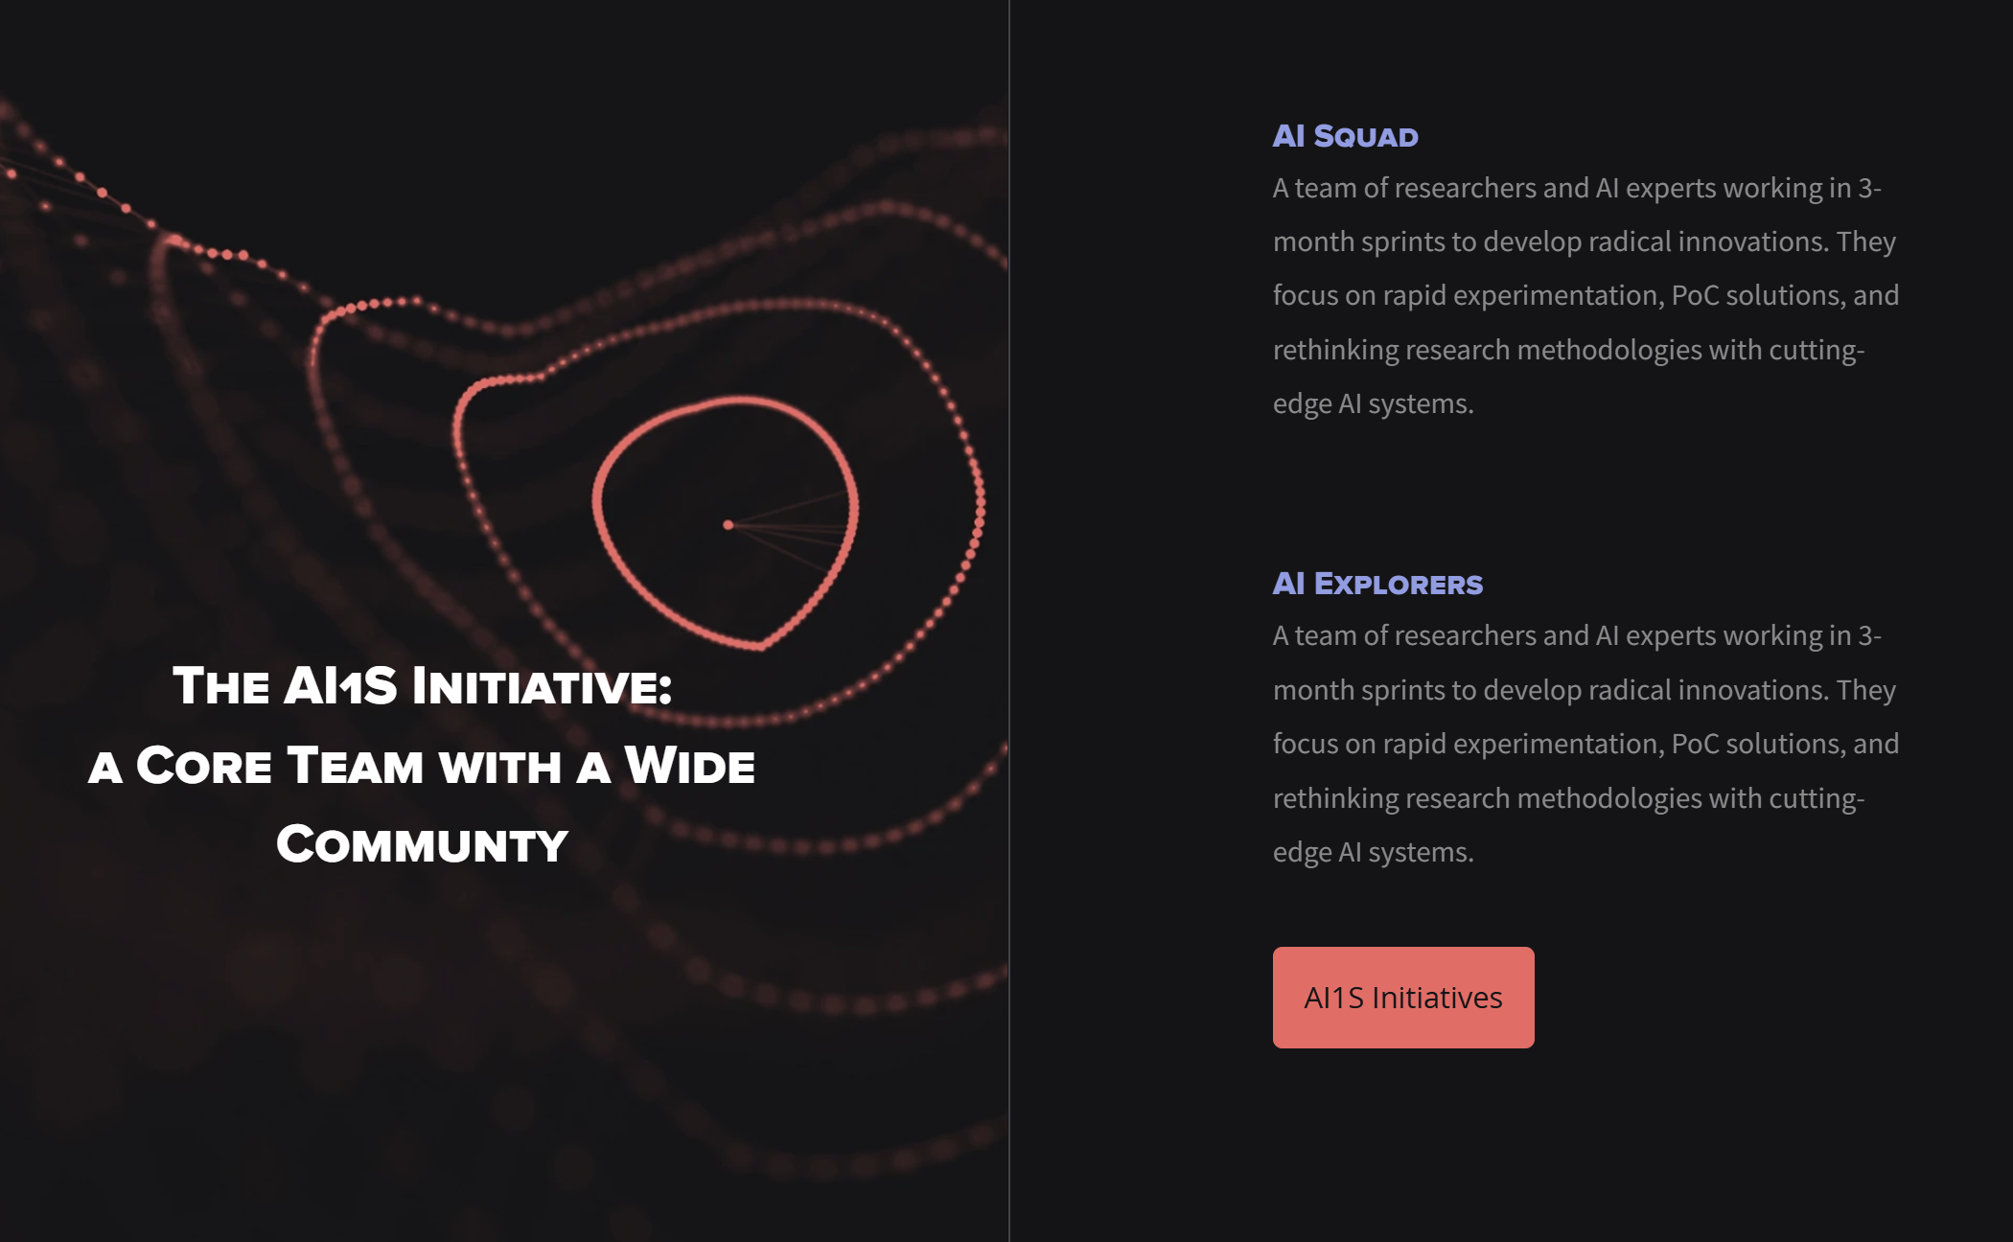
AI-first Science – www.ai1science.com
AUTONOMOUS Intelligence

Slide 11
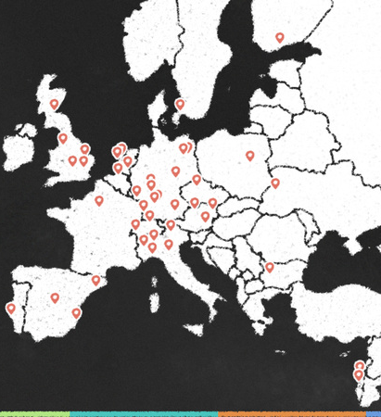
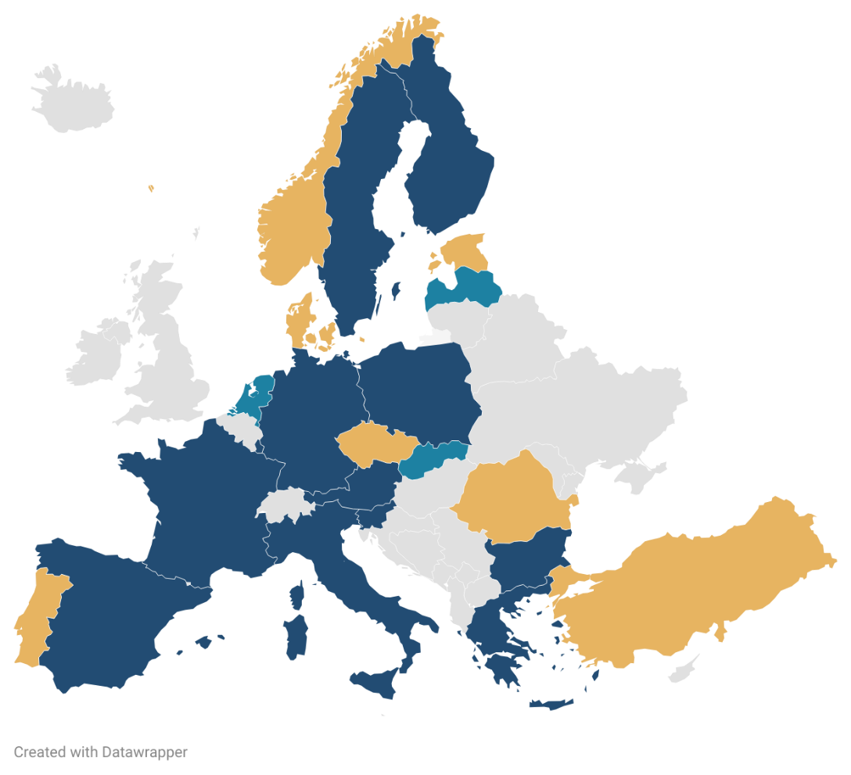
AI Research Ecosystem – Hungary
ELLIS unit
European research alliance
AI Factory
European infrastruc-ture
HUN-REN
AI research
MILAB
Research lighthouse
AI1Science

Slide 12
Thank you for your attention!
https://hun-ren.hu/ai4impact-hu
www.ai1science.com

