Slide 1


pLM-SAV
mino acid
A Delta-Embedding Approach for Predicting Pathogenic Single Amino Acid Variants
rotein
anguage
odel
ingle
varinat
Orsolya Gereben, Hedvig Tordai, Tamás Hegedűs
ogereben@hegelab.org
SEMMELWEIS University, 1769
Institute of Biophysics and Radiation Biology
HUN-REN-SU Biophysical Viorology Research Group
hegelab.org

Slide 2
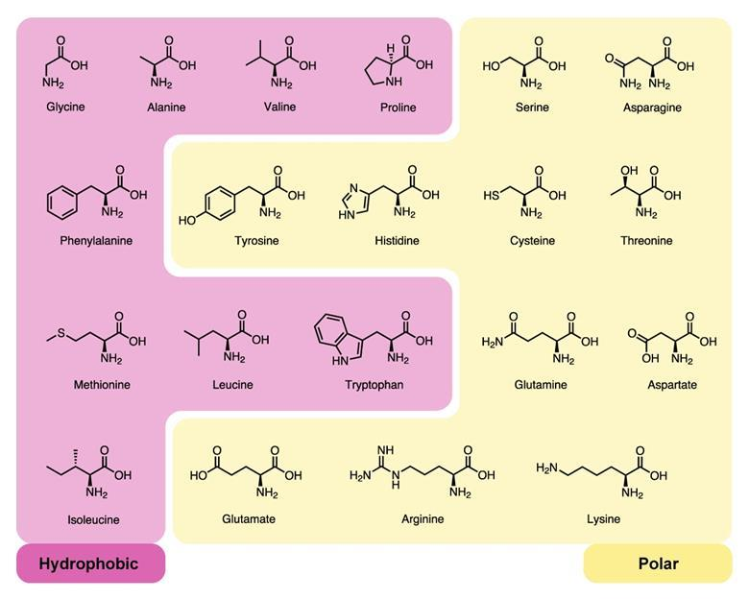
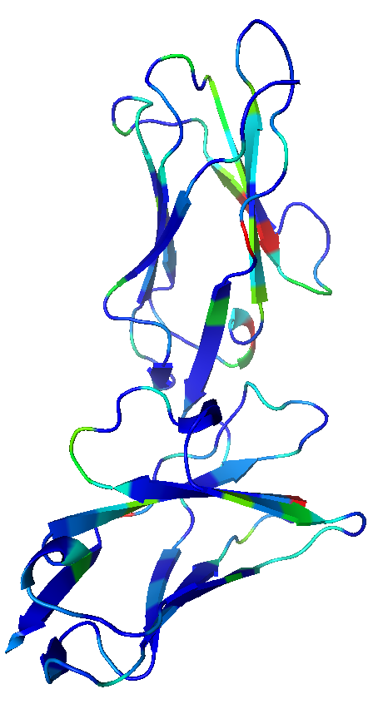
Proteins: structure, sequence
www.chemistryworld.com
GPLPKPTLWAEPGSVISWGNSVTIWCQGTLEAREYRLDKEESPAPWDRQNPLEPKNKARFSIPSMTEDYAGRYRCYYRSPVGWSQPSDPLELVMTGAYSKPTLSALPSPLVTSGKSVTLLCQSRSPMDTFLLCKERAAHPLLCLRSEHGAQQHQAEFPMSPVTSVHGGTYRCFSSHGFSHYLLSHPSDPLELIVSG
GPLPKPTLWAEPGSVISWGNSVTIWCQGTLEAVEYRLDKEESPAPWDRQNPLEPKNKARFSIPSMTEDYAGRYRCYYRSPVGWSQPSDPLELVMTGAYSKPTLSALPSPLVTSGKSVTLLCQSRSPMDTFLLCKERAAHPLLCLRSEHGAQQHQAEFPMSPVTSVHGGTYRCFSSHGFSHYLLSHPSDPLELIVSG
SEMMELWEIS University, 1769
Institute of Biophysics and Radiation Biology
HUN-REN-SU Biophysical Viorology Research Group
hegelab.org

Slide 3
Protein Language Models (pLM)
0
1
1
…
transfer-learning: using embeddings as input for supervised models
Machine learning model
binary classifier
e.g. logistic regression and NN
context awarness
vector length depends on the pLM
could be extracted from the pLM
V₁
V₂
V₃
V_{L}
L amino acid embeddings
Prot-T5 (N=1024)
[PMID: 34232869]
Ankh (N=1536)
[bioRxiv: 10.1101/2023.01.16.524285]
Self-attention layers
transformer model
decoder
encoder
Tokenization & encoding
Input of length L
S
E
Q
…
SEMMELWEIS University, 1769
Institute of Biophysics and Radiation Biology
HUN-REN-SU Biophysical Viorology Research Group
hegelab.org

Slide 4
Idea
For a variant with SAV at the ith amino acid the
Δembedding: embedding[i]_{wt} – embedding[i]_{var}
a variant is represented by a vector with dimension N
wild type
-
variant
Protein with L amino acid will be represented with L*N real numbers, where N is the embedding dimension
SEMMELWEIS University, 1769
Institute of Biophysics and Radiation Biology
HUN-REN-SU Biophysical Viorology Research Group
hegelab.org

Slide 5
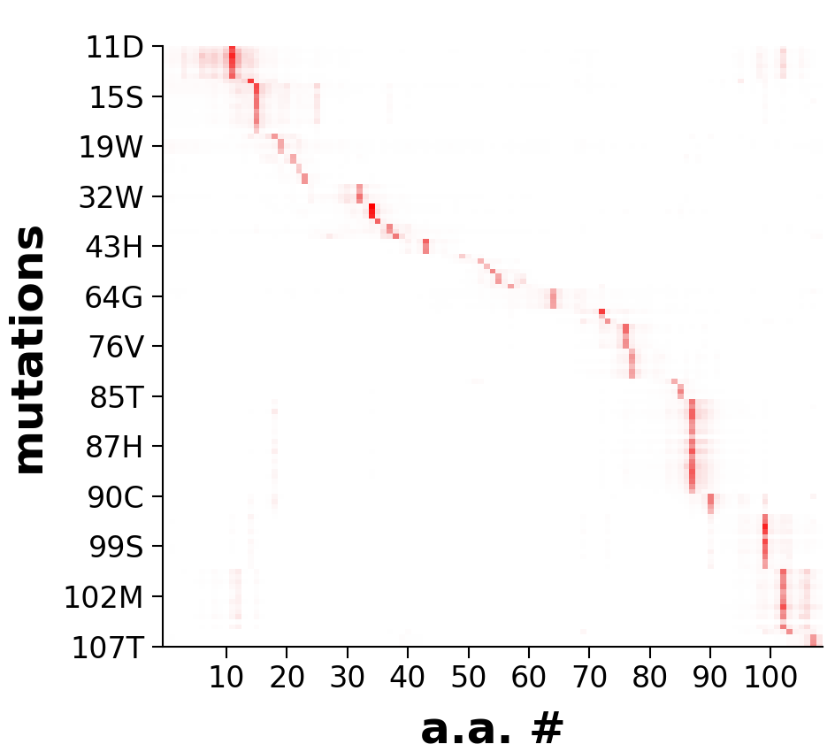
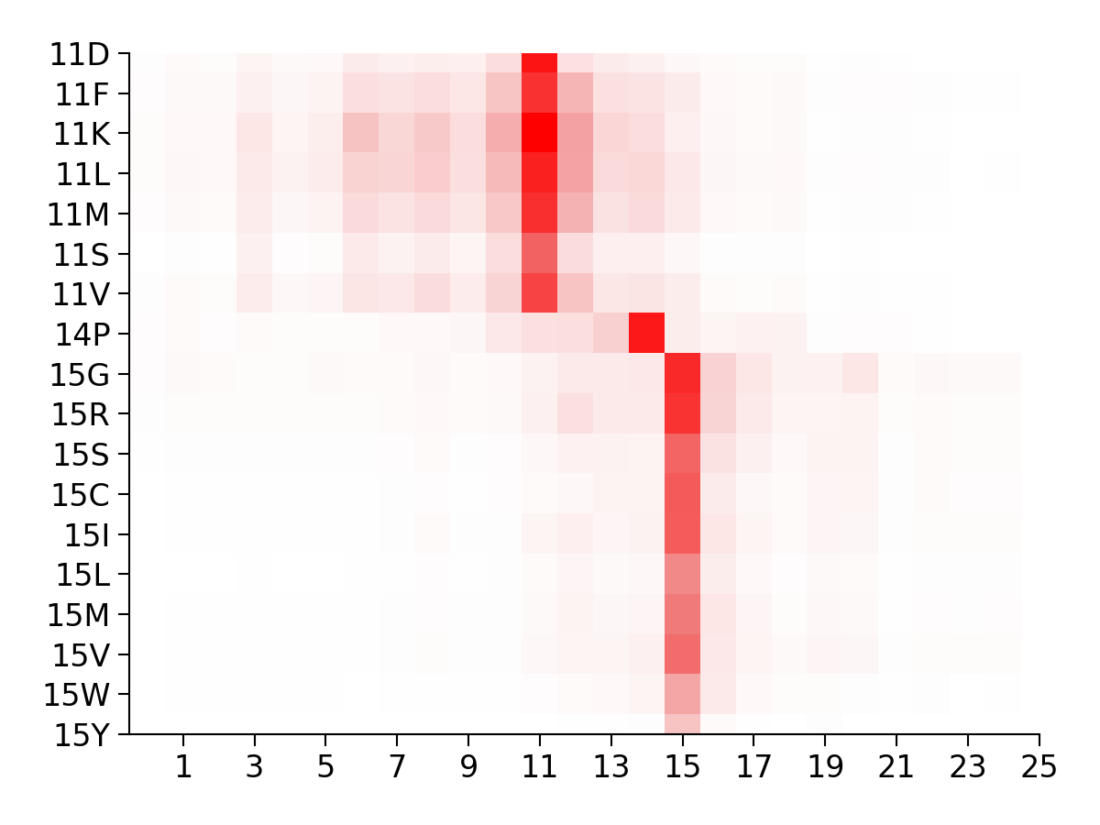
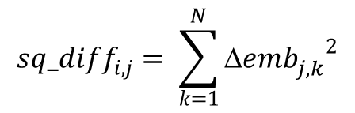
Representation of the Δ-embeddings
Squared difference
7 amino acid window
$${sq_diff}_{i,j}^{}= \sum_{k=1}^{N}{{{Δemb}_{j,k}^{}}^{2}}$$
(i)
Simple
Does it work?
Training a CNN on the Eff10k data set
0.2
0.4
0.6
0.8
1.0
(j)
Cytochrome c isoform 1
(UniProt acc: P00044)
SEMMELWEIS University, 1769
Institute of Biophysics and Radiation Biology
HUN-REN-SU Biophysical Viorology Research Group
hegelab.org

Slide 6
Similar methods
VESPA supervised learning, trained on Eff10k : protein language model embeddings to infer conservation, BLOSUM substitution scores, substitution probabilities [Marquet et al. PMID:34967936]
SNAP2 supervised learning, trained on Eff10k, evolutionary information from sequence alignments, biophysical amino acid properties, secondary structure, solvent accessibility, residue flexibility, SWISS-Prot annotations, predicted binding residues, predicted disordered regions, statistical contact potentials, functional annotations from Pfam and PROSITE, and amino acid property indices from Aaindex [Hecht et al PMID:26110438]
AlphaMissense (AM) is based on AlphaFold unsupervised protein language modeling to learn amino acid distributions conditioned on sequence context, incorporating structural context by using an AlphaFold-derived system; fine-tuning on weak labels from population frequency data, thereby avoiding bias from human-curated annotations [Cheng et al., PMID: 37733863]
REVEL (nucleotide-based) ensemble method for predicting the pathogenicity of missense variants based on a combination of scores from 13 individual tools: MutPred, FATHMM v2.3, VEST 3.0, PolyPhen-2, SIFT, PROVEAN, MutationAssessor, MutationTaster, LRT, GERP++, SiPhy, phyloP, and phastCons [Ioannidis et al., 27666373]
SEMMELWEIS University, 1769
Institute of Biophysics and Radiation Biology
HUN-REN-SU Biophysical Viorology Research Group
hegelab.org

Slide 7
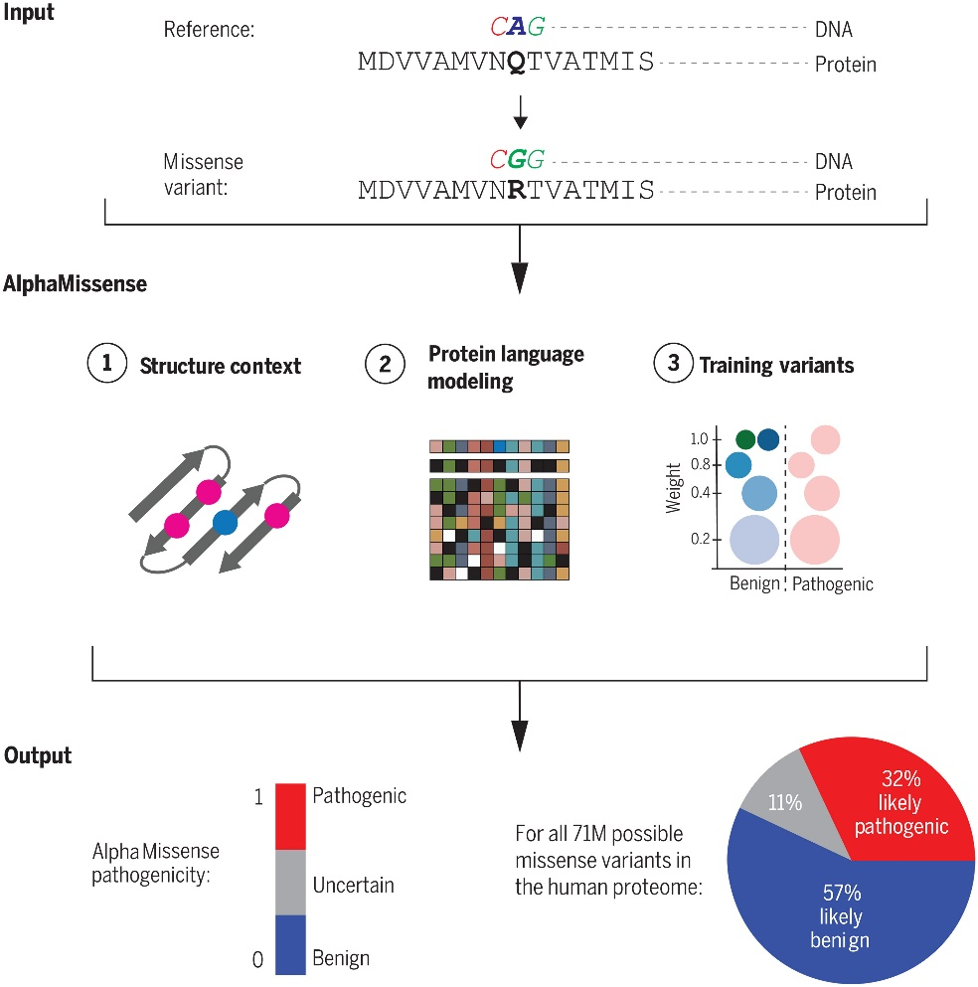
AlphaMissense.hegelab.org
Cheng et al. Science 2023
Collecting data for ABC proteins
Tested different groups of proteins
Presented in a simple, easy to access way
SEMMELWEIS University 1769
Department of Biophysics and Radiation Biology
HUN-REN-SE Biophysical Virology Research Group
hegelab.org

Slide 8
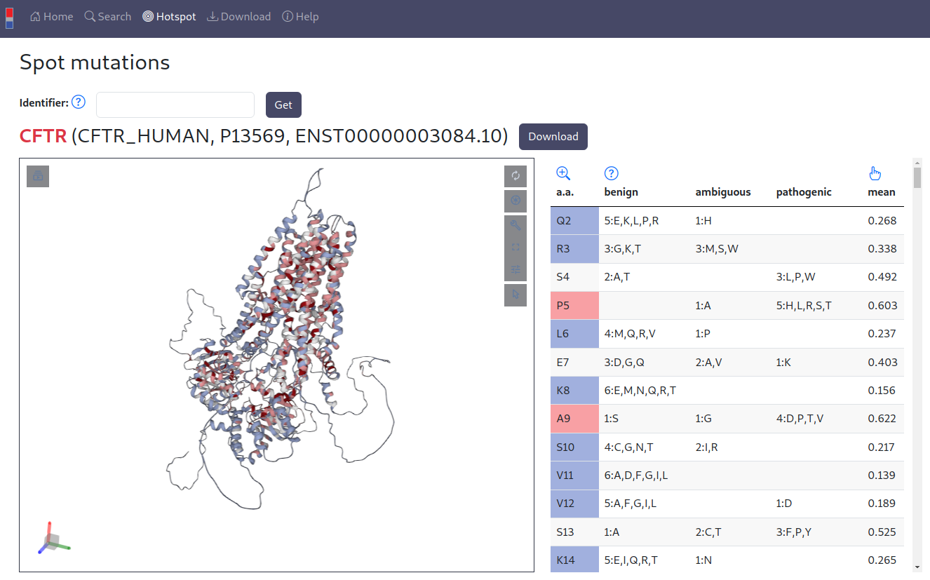
AlphaMissense.hegelab.org
Tordai et al. Sci Data 2024
SEMMELWEIS University, 1769
Institute of Biophysics and Radiation Biology
HUN-REN-SU Biophysical Viorology Research Group
hegelab.org

Slide 9
Training: Eff10k (SNAP2) data set
human and non-human proteins, categorized as neutral or effect (~ 100000 variants)
10 folds: proteins clustered by sequence similarity, one fold (Fold 0) is much larger than the others
method ‘A’: 10-fold cross validation with valid and test, 10 different trained models, averages
test fold was not involved in the training of a particular model, independent (Fold i)
method ‘B’: 9-fold cross validation with valid and test, 9 different trained models, averages
test fold and Fold 0 was not involved in the training of a particular model, independent (Fold i, Fold i + Fold 0)
Inference: ClinVar, PMD4k, AM, REVEL, ProteinGym1 data sets
subset of ClinVar data set, not similar in sequence to the training and validation sets, ensemble predictions
(A: ~18000, B: ~84000 variants)
PMD4k is a subset of Eff10k, only not sequence similar proteins used similarly as for Eff10k test set
subset of AM data set also predicted by REVEL and having ClinVar label, not similar in sequence to the training and validation sets, ensemble predictions (B: ~46500 variants)
SEMMELWEIS University, 1769
Institute of Biophysics and Radiation Biology
HUN-REN-SU Biophysical Viorology Research Group
hegelab.org

Slide 10
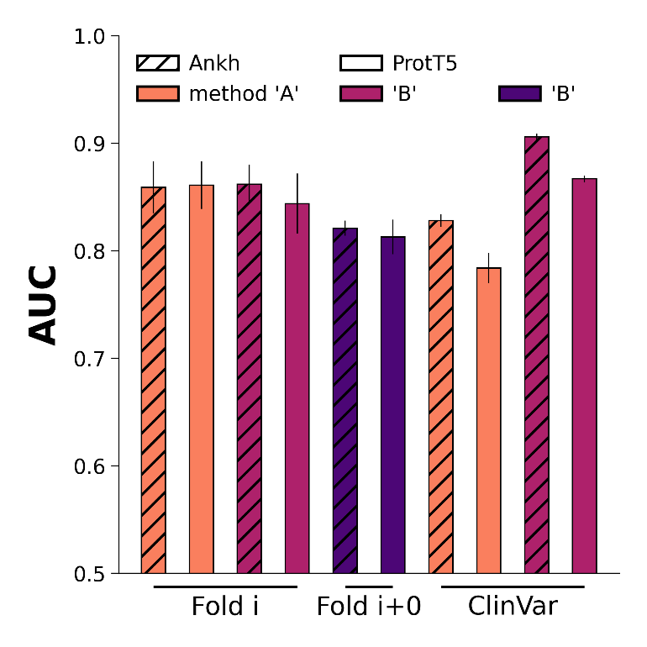
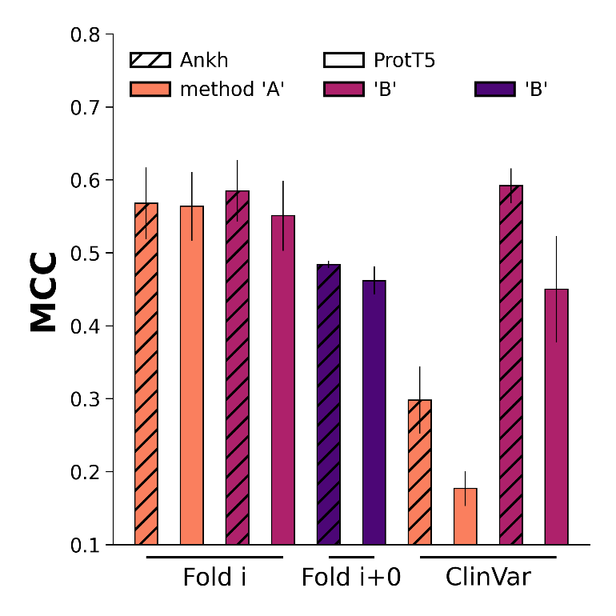
Performance
SEMMELWEIS University, 1769
Institute of Biophysics and Radiation Biology
HUN-REN-SU Biophysical Viorology Research Group
hegelab.org

Slide 11
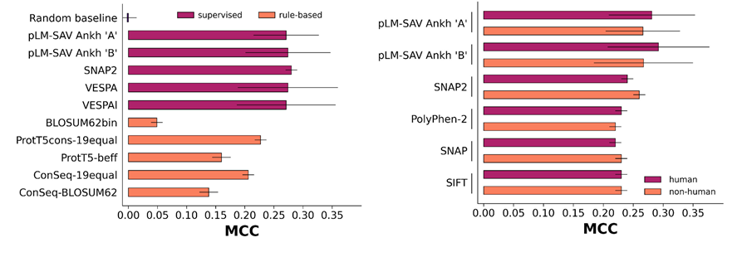
Performance compared to SNAP2 and VESPA

Slide 12
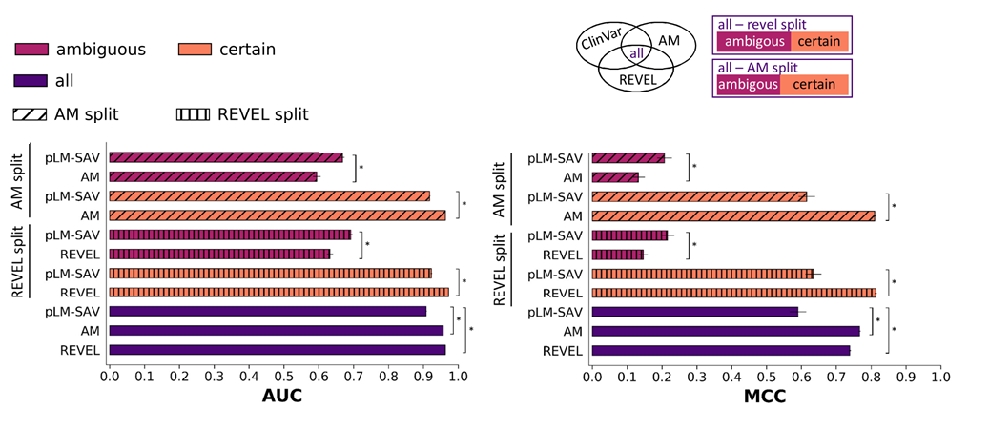
Performance compared to AlphaMissense and REVEL
0 1
0 ambiguous 1 binary classification
AM ambiguous set: 15 % of the whole set
benign
0 probability 1
pathogenic
method ‘B’ Ankh results
SEMMELWEIS University, 1769
Institute of Biophysics and Radiation Biology
HUN-REN-SU Biophysical Viorology Research Group
hegelab.org

Slide 13
Conclusions
4 different pLM-SAV predictors were trained (‘A’, ‘B’ both with Ankh or ProtT5), all gives statistically significant predictions
Ankh seems to be better than ProtT5 for this task
‘B’ Ankh proved to be the best
can be used for predictions for any species
it is quick and does not require a lot of resources
it surpasses other methods like the complex SNAP2 on some of the benchmarks
compared to the state-of-the-art AM and REVEL it is only better on the ambiguous sets
REVEL might be a good source for more reliable predictions on the AM ambiguous set
although this method in itself not better than the state-of-the-art and probably will not be used in itself, but using Δembeddings as an additional feature can be recommended
SEMMELWEIS University, 1769
Institute of Biophysics and Radiation Biology
HUN-REN-SU Biophysical Viorology Research Group
hegelab.org

Slide 14
Thanks for your attention!
Institute of Biophysics and Radiation Biology
Semmelweis University, Budapest, HU
HUN-REN-SU Biophysical Virology Research Grouop
www.hegelab.org
Tamás Hegedűs
Orsolya Gereben
Eszter Kozák
Kriszti Lór
Rita Padányi
Hedvig Tordai
Blanka Berta
Lana Khamisi
Karen Torres
NKFIH 137610
TKP2021-EGA-23
HU-RIZONT-2024-00003
HUN-REN Wigner GPU-lab
KIFÜ HPC KK (Komondor)
SEMMELWEIS University, 1769
Institute of Biophysics and Radiation Biology
HUN-REN-SU Biophysical Viorology Research Group
hegelab.org

